Slide 2
Notes:
The Wonderful Bible [presentation time approximately 20-25 minutes]
Welcome boys and girls! Most of you all know what a Bible is. But today we are going to discover many things about the Bible that will surprise you! Let’s start with a story.

Slide 3
Notes:
Stephen had an aunt who was very old. When his aunt died, a court read her will to him. A will is a legal paper that says what should happen to the things that belonged to the person who passed away.

Slide 4
Notes:
In her will were these words that she wrote before she died: “To my beloved Steven, on this list I have written some personal items that I want you to have. Included is my family Bible.”

Slide 5
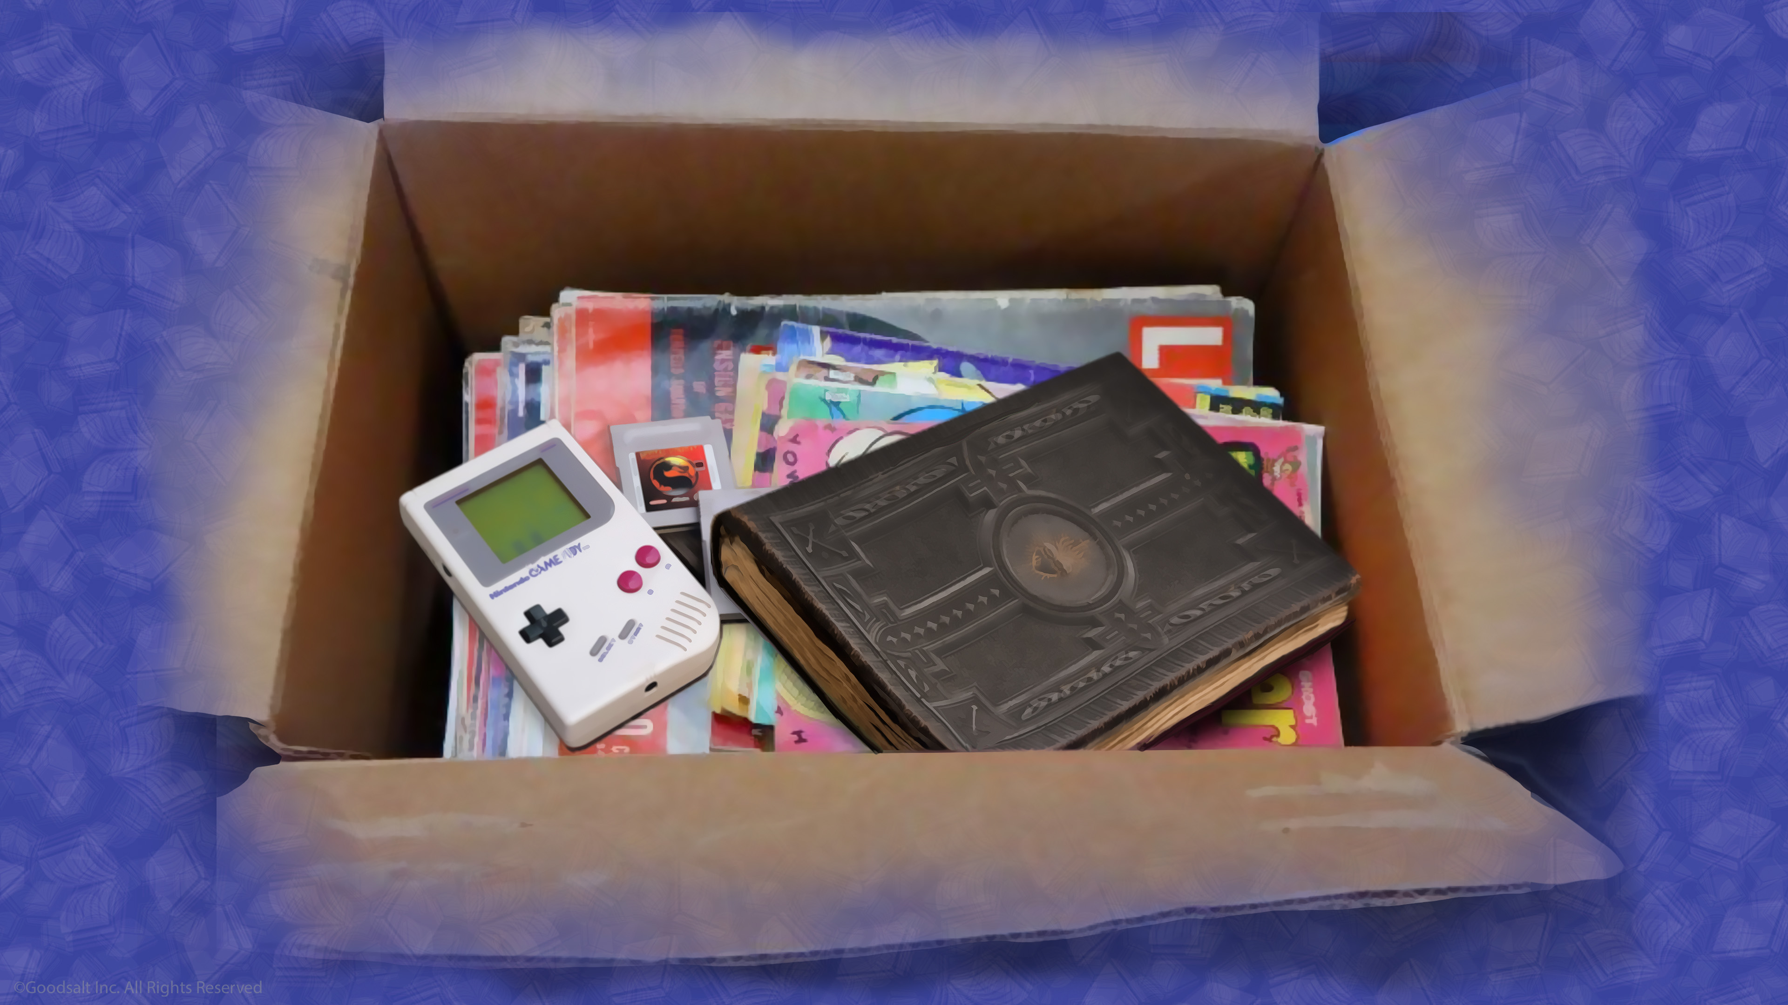
Notes:
Since Steven was not a religious man he put the old Bible in a cardboard box in his attic. Some of the things he inherited he sold for money, but soon the money was gone.

Slide 6
Notes:
Many years went by. Stephen had some health problems that prevented him from having a good job, so he lived most of his life in poverty, barely having enough money to get groceries and pay his bills.

Slide 7
Notes:
5. Finally, in his old age, he decided to move into his son’s home. While packing up his belongings, he found the old box in the attic with the Bible in it. As he picked it up, he decided to open the Bible. As he turned a few pages he discovered something that astonished him!

Slide 8
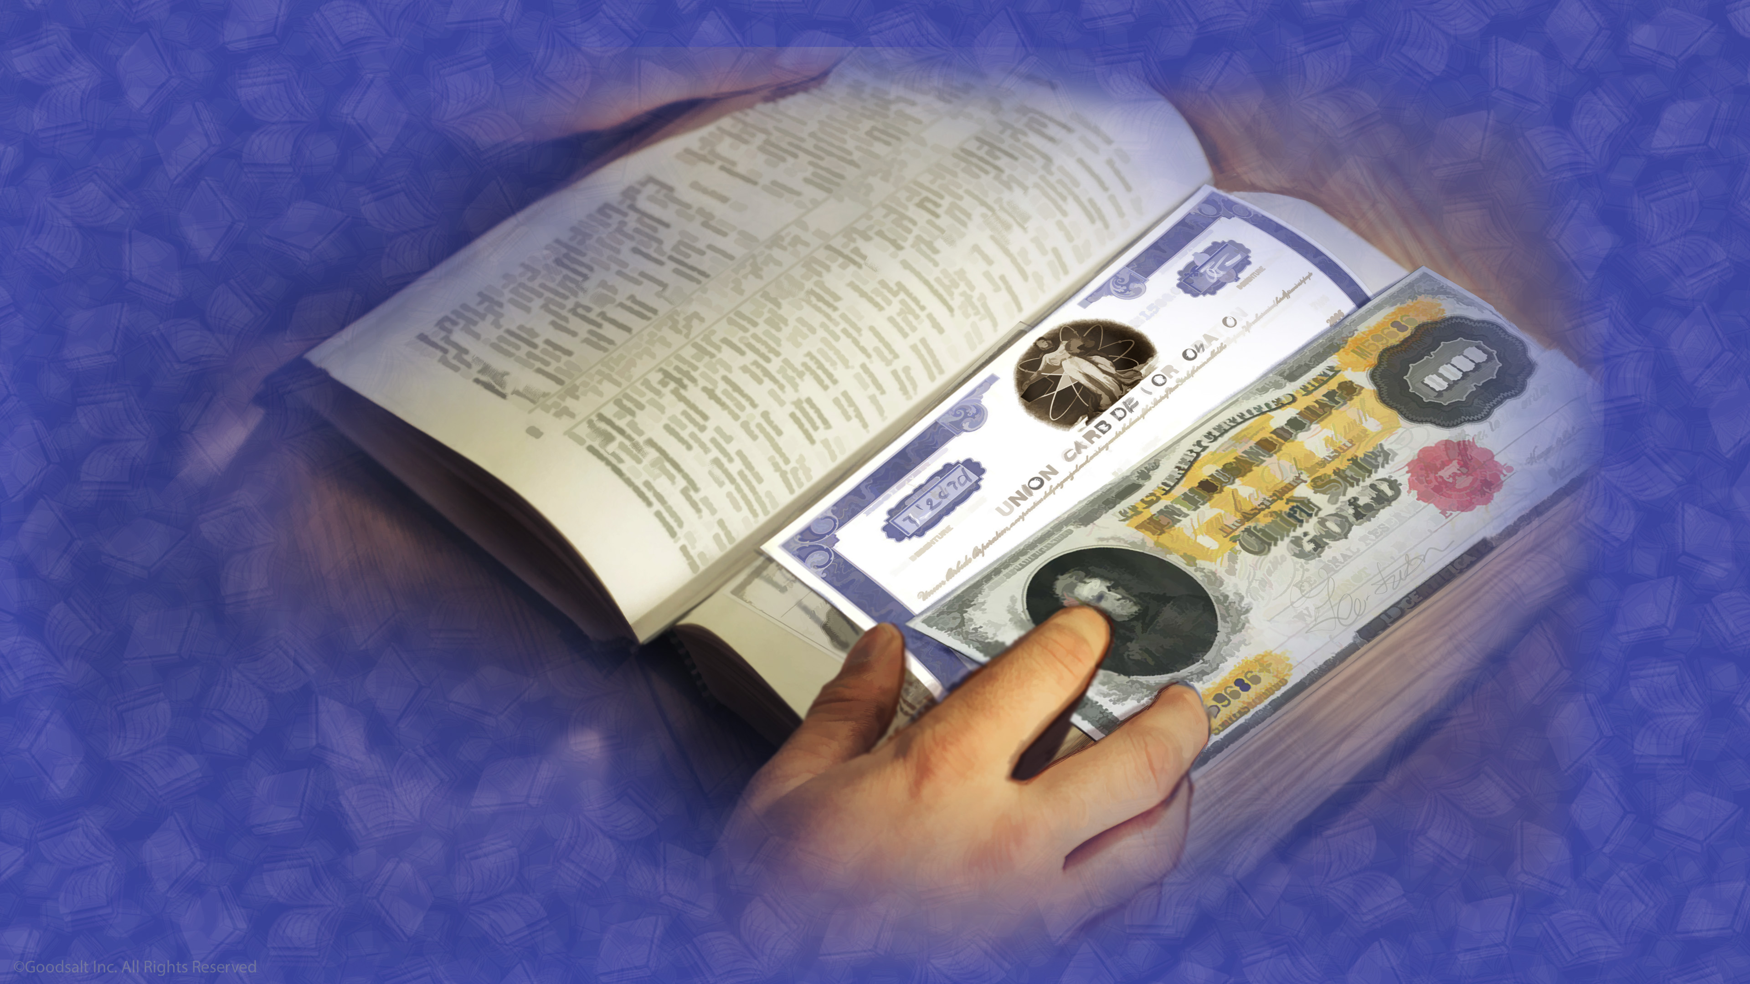
Notes:
Inside scattered all through the Bible were banks notes worth thousands of dollars!
All his life this man had lived in poverty when all along there was a great treasure of money in his own house.

Slide 9
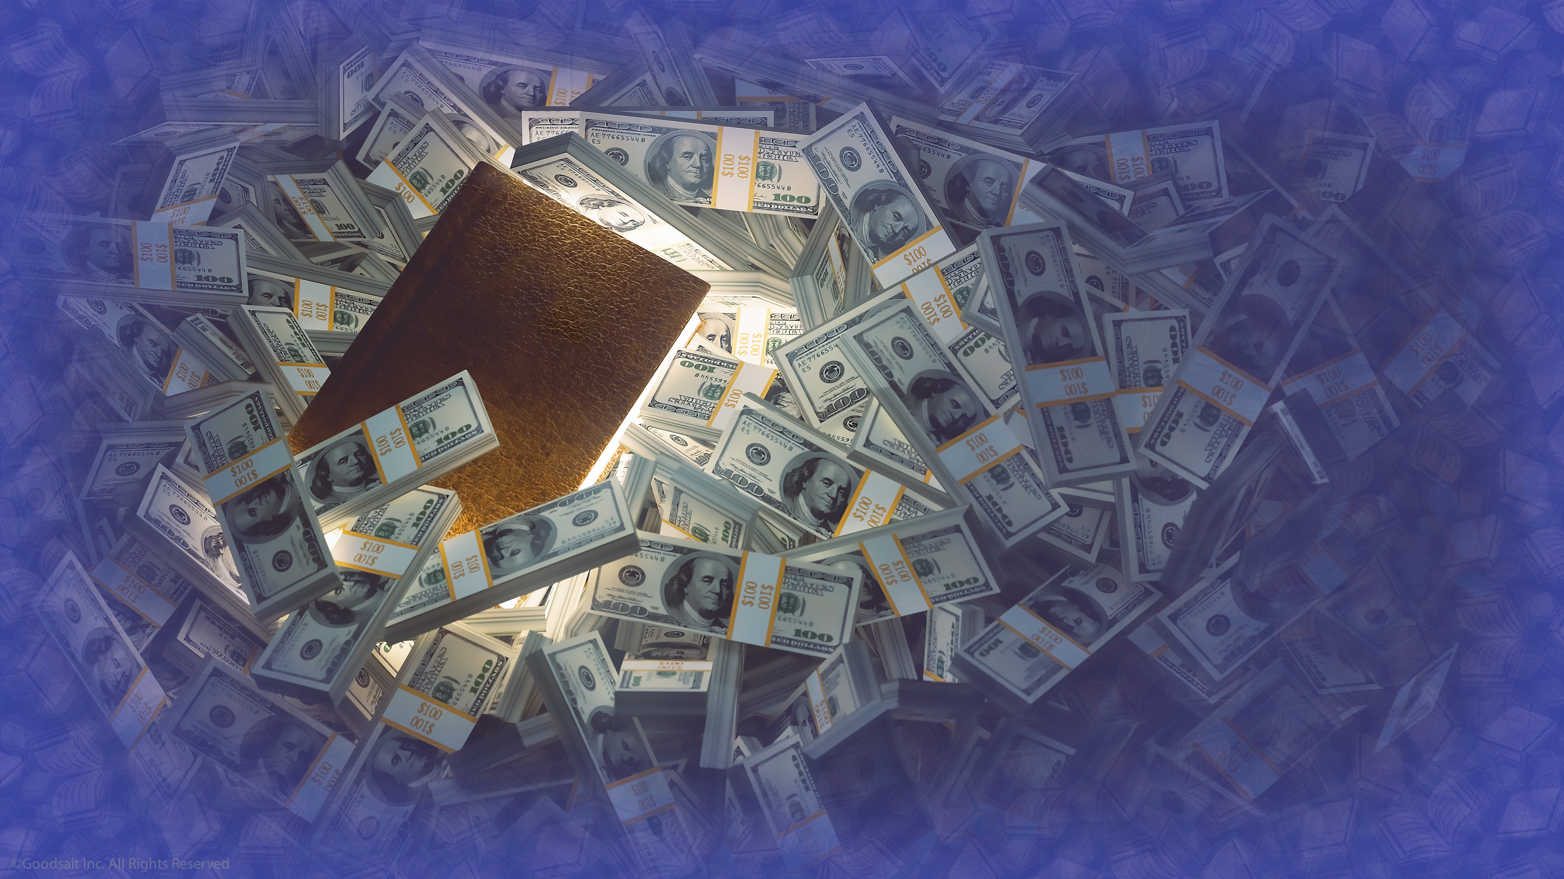
Notes:
But the Bible has a greater treasure in it than any amount of money is worth. The treasure in the Bible is God’s plan of salvation for you and me. It is priceless.

Slide 10
Notes:
Jesus said "For what good will it do a person if he gains the whole world, but forfeits his soul?” There is nothing more important than our salvation.

Slide 11
Notes:
The Bible does something that no other book in the world does: It is the inspired message of God that tells us WHY the world is the way it is. That includes all the good things in the world and all the horrible things in the world, including why there is sadness and death.

Slide 12
Notes:
The Bible tells us WHAT God has done to fix the problem of sin and selfishness, and how things will turn out for those who love and obey Him.

Slide 13
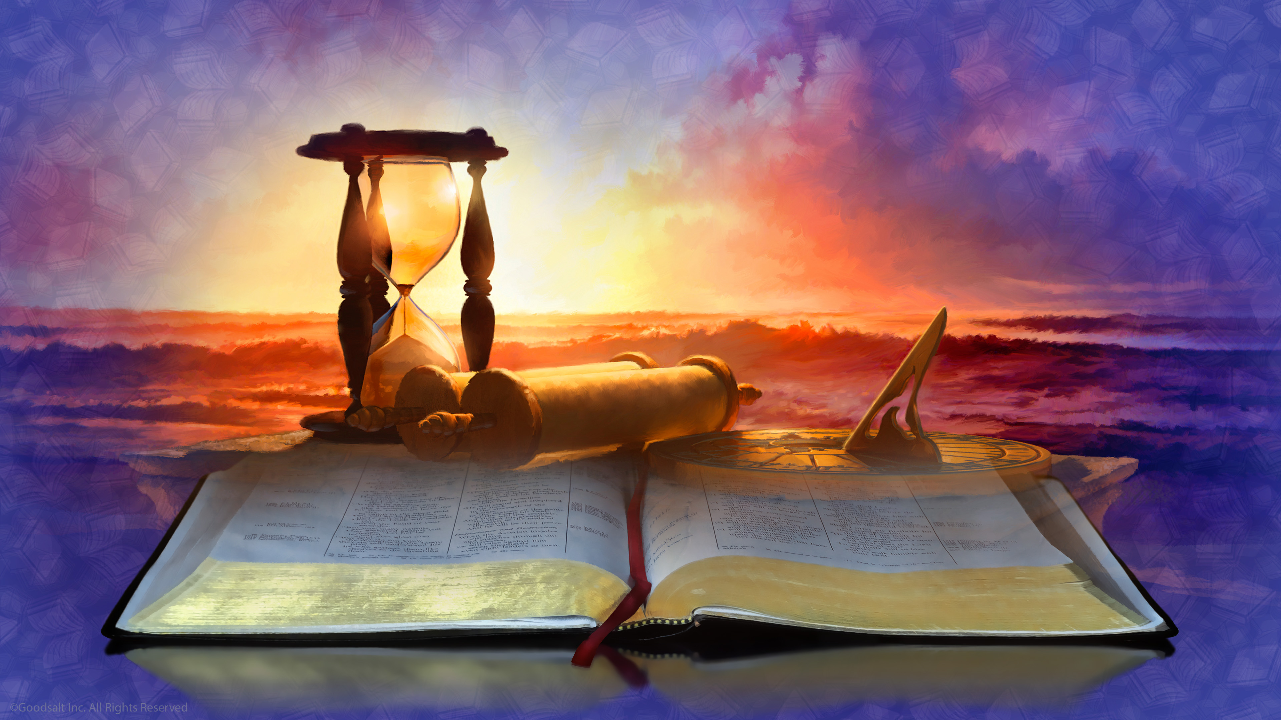
Notes:
The Bible also tells us WHEN God will finish His work and return to Earth.

Slide 14
Notes:
And the Bible tells us HOW to have faith in the work Jesus has done for us, and how He wants us to live.

Slide 15
Notes:
People of every nationality, language group, and ethnic background have discovered that God’s Word is a precious treasure. It is His love letter to them!

Slide 16
Notes:
Let’s explore what is known about this fascinating book. Actually, it is not just one book but it’s actually sixty-six books, written at different times by different authors over a period of 1,600 years.

Slide 17
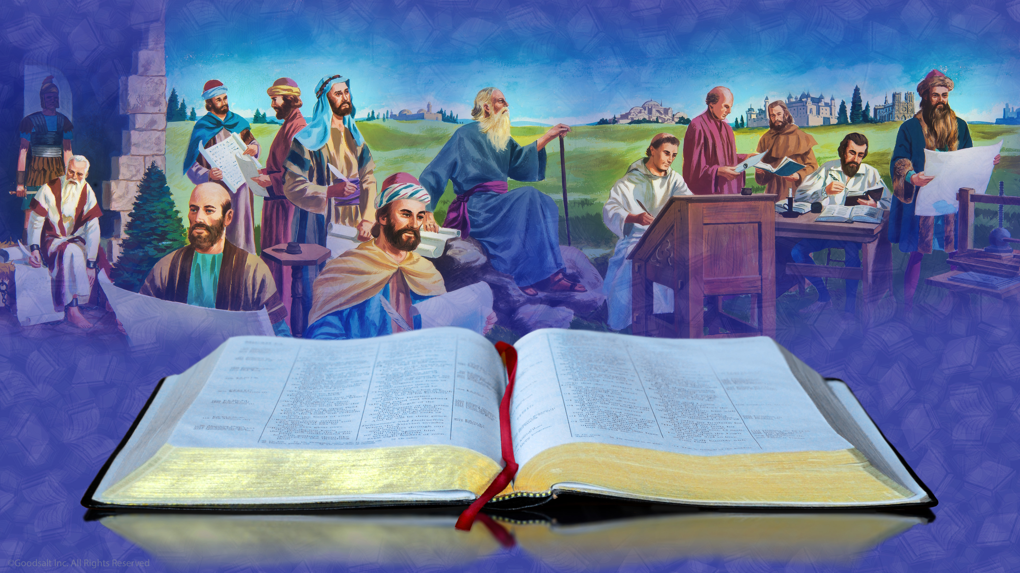
Notes:
Forty-five completely different authors wrote these books, and yet these books agree perfectly with each other. No author writes something that contradicts another.
These Bible writers were fishermen, shepherds, preachers, farmers, statesmen, kings, and even a physician. Yet there complete agreement between them. So why do all these books seem to agree, especially when most of these authors never knew each other?

Slide 18
Notes:
The reason is that every author was inspired to write by the same Spirit of God. Jesus’ disciple Peter explains it to us: “For prophecy never came by the will of man,

Slide 19
Notes:
but holy men of God spoke as they were moved by the Holy Spirit” (2 Peter 1:21).

Slide 20
Notes:
The Apostle Paul agreed, writing that “All scripture is given by inspiration of God, and is profitable for doctrine, for reproof,

Slide 21
Notes:
for correction, for instruction in righteousness, that the man of God may be complete,

Slide 22
Notes:
thoroughly equipped for every good work” (2 Timothy 3:16, 17).

Slide 23
Notes:
So why did God inspire these men to write down these WHY, WHAT, WHEN, AND HOW for us? Instead of a Bible, why didn’t God just send inspired messages directly to us?

Slide 24
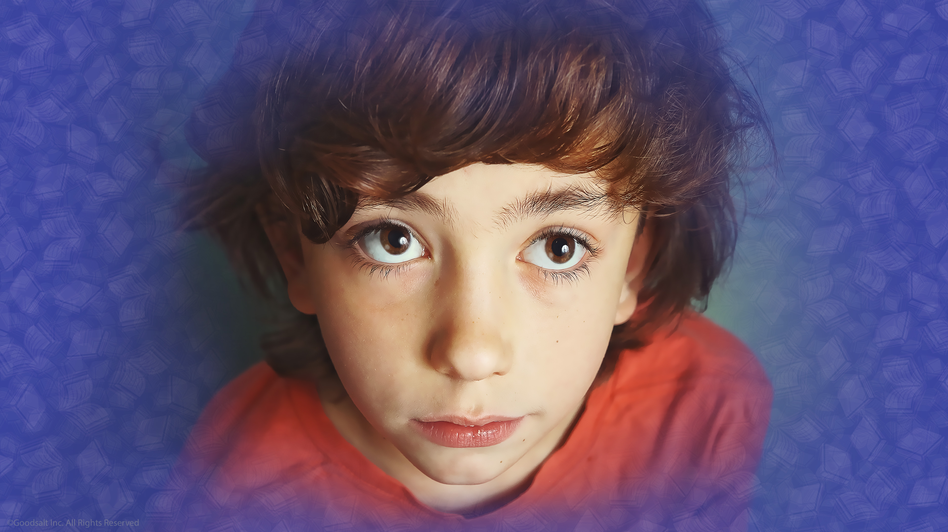
Notes:
So why did God inspire these men to write down these WHY, WHAT, WHEN, AND HOW for us? Instead of a Bible, why didn’t God just send inspired messages directly to us?

Slide 25
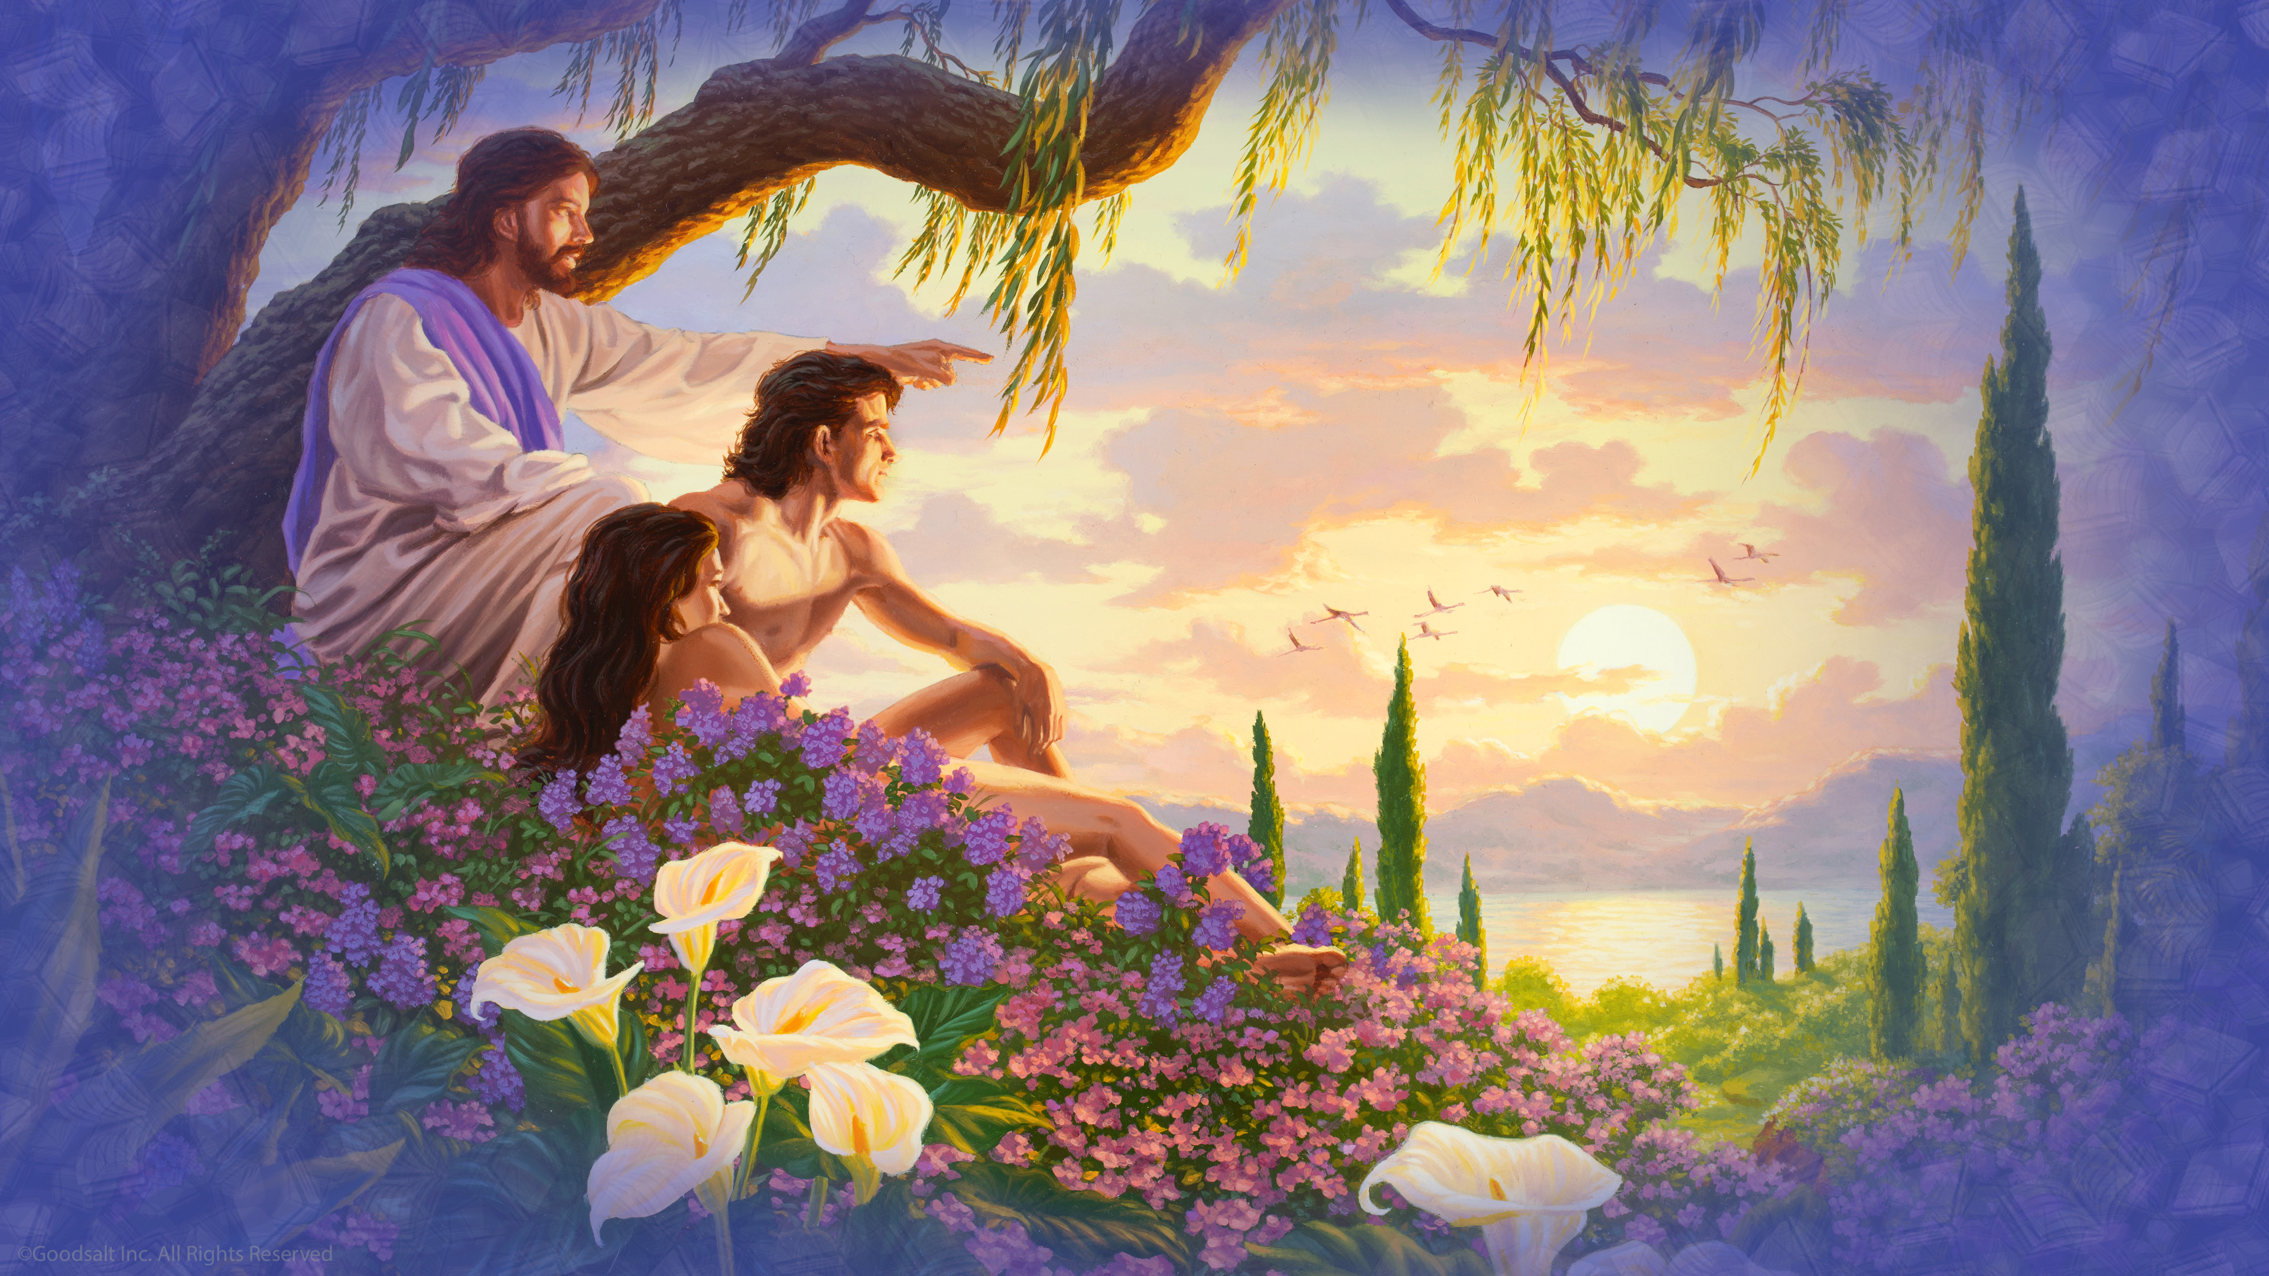
Notes:
Before sin came into our world, the Bible tells us that Jesus walked with the man and woman that He had created every day! What wonderful conversations they must have had.

Slide 26
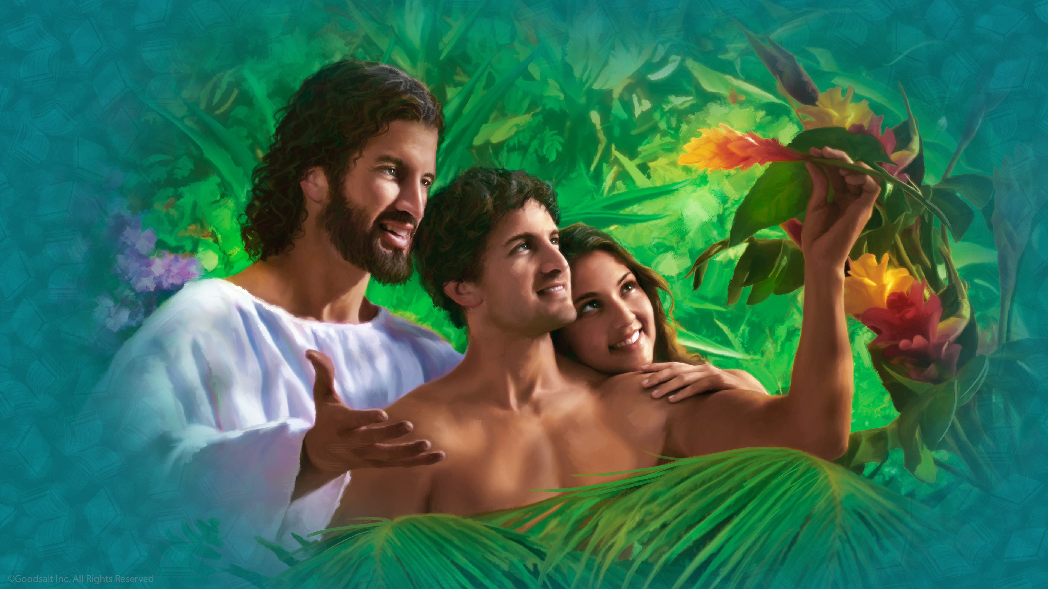
Notes:
I can imagine Jesus asking “Adam, did you notice those beautiful red orchid flower growing near the waterfalls at the east end of the garden? They are very similar to the ones I created on another world that I made. I knew that you and Eve would like them.”
Adam might answer “Oh, I have seen them, Lord! They are so beautiful! But not as beautiful as my Eve. I believe she is the most wonderful creation You ever made!”

Slide 27
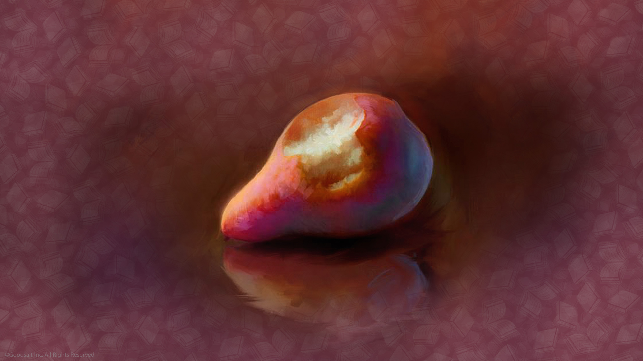
Notes:
But when Adam and Eve disobeyed God and ate the fruit that He warned them never to eat, sin, selfishness, and guilt entered our world. When Jesus came for His daily visit with this perfect couple, they did not meet Him at the usual place. Instead they hid in the bushes.

Slide 28
Notes:
Sin had separated them from their Creator. What a sad day that was.

Slide 29
Notes:
How could God again talk with sinful people? God wisely decided to reveal what He wants us to know through the Bible. The Book of Amos says “Surely the Lord God does nothing, unless He reveals His secret to His servants the prophets”. (Amos 3:7)

Slide 30
Notes:
One of the HOW parts of the Bible reveals to us the God’s ideas for healthy living, how God wants us to take care of our bodies. So let’s pause for a moment to discover something new in this Health Gem.

Slide 31
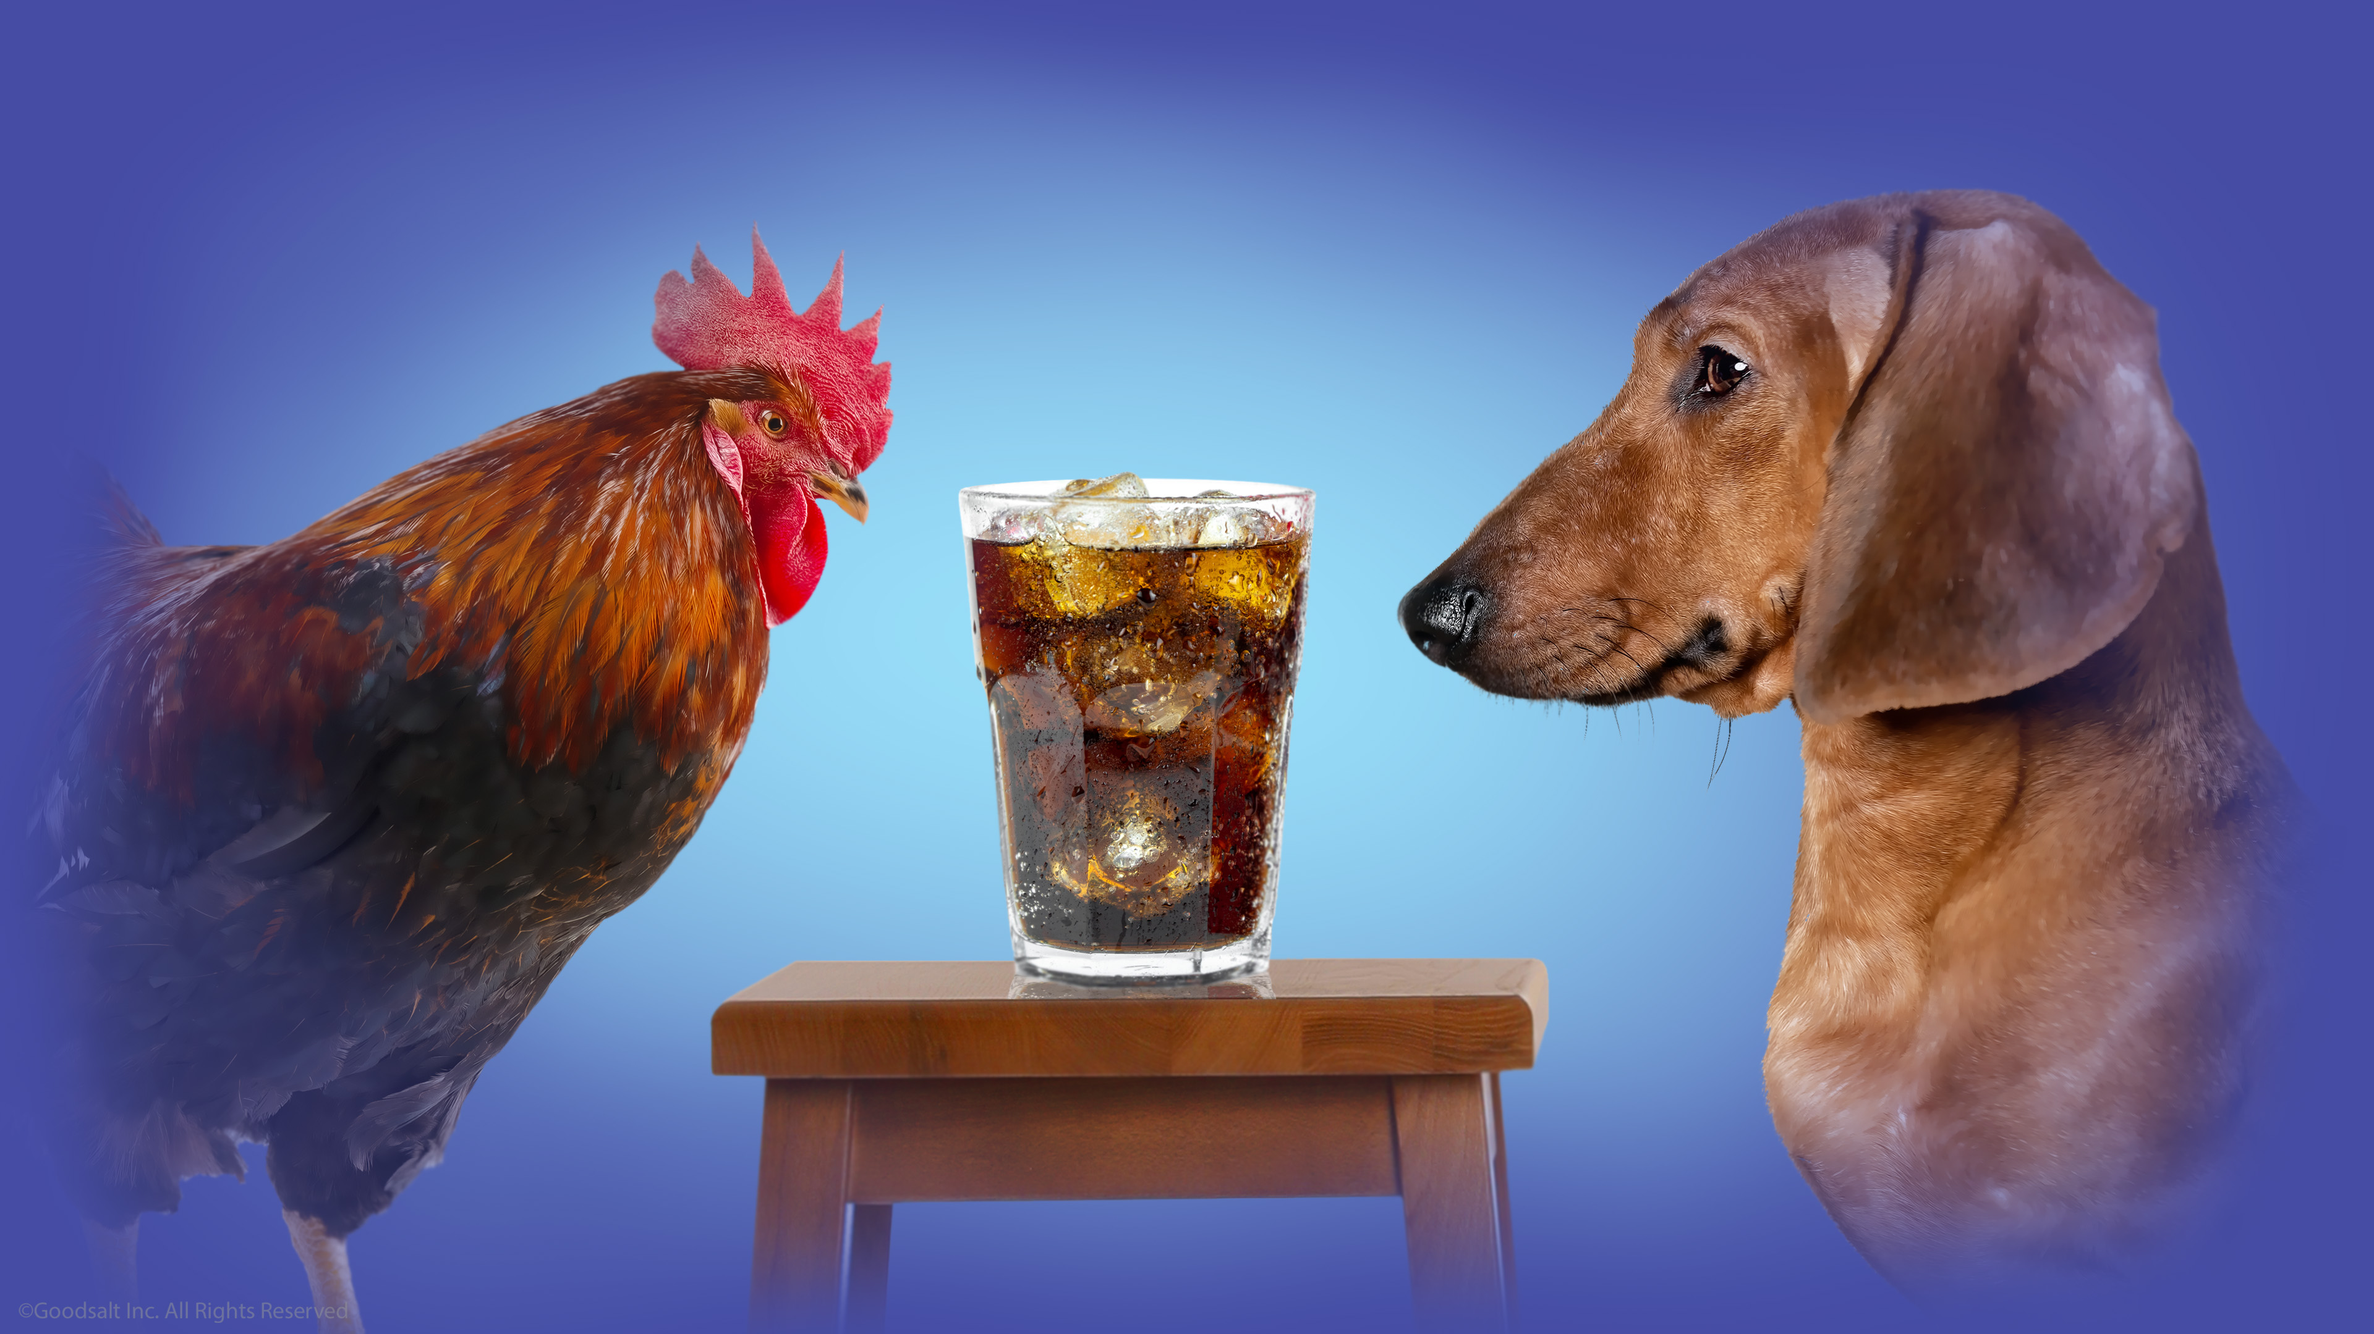
Notes:
Did you know that God created a special beverage to drink? And this beverage is the same one for every animal in the world? It’s not soda pop, it’s not a sugar drink, and it’s not chocolate milk.

Slide 32
Notes:
You have probably guessed. It’s water! All living things depend on water. Not just for drinking, but we also need it for bathing, to clean our teeth, and to wash our clothes.

Slide 33
Notes:
Just as we need water to make things clean around us, we also need it for keeping our insides clean! That’s right, water keeps you clean and healthy on the inside. Drinking water is the way that the body takes out the toxic wastes that are left over when you eat food. This is why it’s wise to drink pure water several times a day.

Slide 34
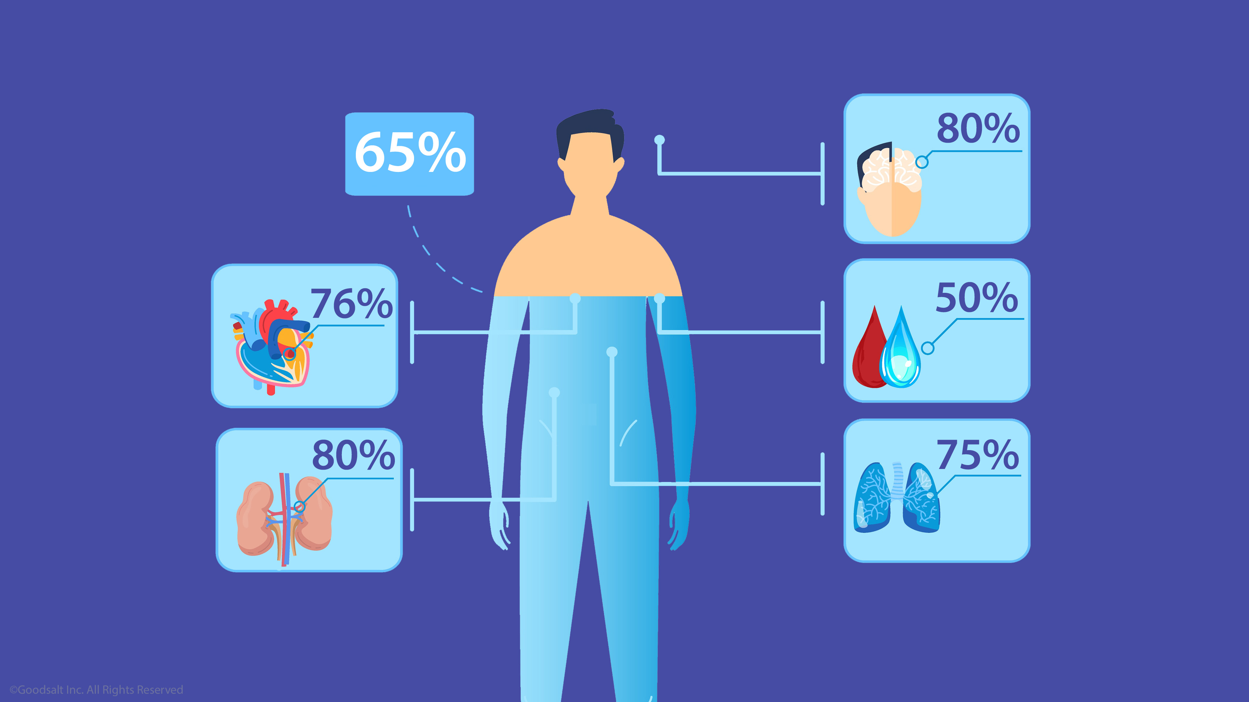
Notes:
After all, there is more water in us than any thing else! In fact, about 65% of our body is water. And that includes important organs like our brain, heart, kidneys, lungs, and blood. And don’t just drink water yourself. Remind your family and friends, “Drinking water is important for good health!”

Slide 35
Notes:
So let’s look more closely at how the Bible has been protected by God down through the centuries. If it was written thousands of years ago, how do we know that it is the same words that were written way back then?

Slide 36
Notes:
There is lots of evidence to show that the Bible we read today is the same that was written by God’s prophets, and the same text
that God’s people read when it was first written.

Slide 37
Notes:
Back when your great grandparents were children, the earliest scrolls we had from the first books of the Bible were copies from around 900 years after Jesus lived on Earth. That’s about 1200 years ago. But then in 1946 a Bedouin shepherd boy discovered a cave near Israel containing ancient scrolls preserved in clay pots.

Slide 38
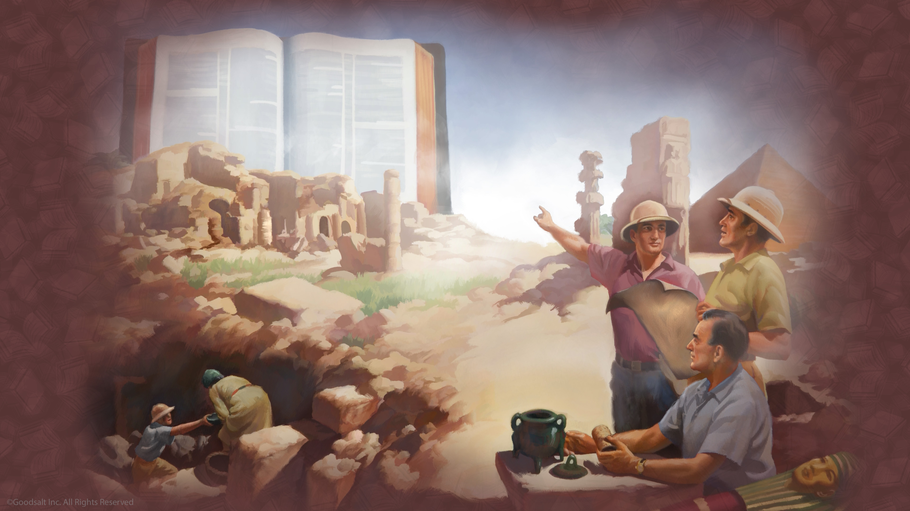
Notes:
Archeologists are experts in studying ancient things. Bible archeologists discovered that these scrolls were written around 125 BC, over a thousand years before the oldest scrolls found up to that time! The scrolls in the clay pots included some entire books of the Bible, such as the book of Isaiah.

Slide 39
Notes:
Now Christians everywhere wanted an important question answered: Did these newly discovered ancient scrolls match the Bible that we have today? Or were there changes or copy errors made through the centuries when the Bible was copied over and over again?

Slide 40
Notes:
When they compared the old scrolls to our Bible today it was discovered that there was no change, only small minor items that did not change the meaning of the Bible at all!

Slide 41
Notes:
The best Bible archeologists have said that “The Christian can take the whole Bible in his hand and say without fear or hesitation...

Slide 42
Notes:
…that he holds in his hands the true Word of God, handed down...

Slide 43
Notes:
… without essential loss from generation to generation throughout the centuries.”

Slide 44
Notes:
As archeologists continue to dig, they continue to find strong evidence that confirms Bible history.

Slide 45
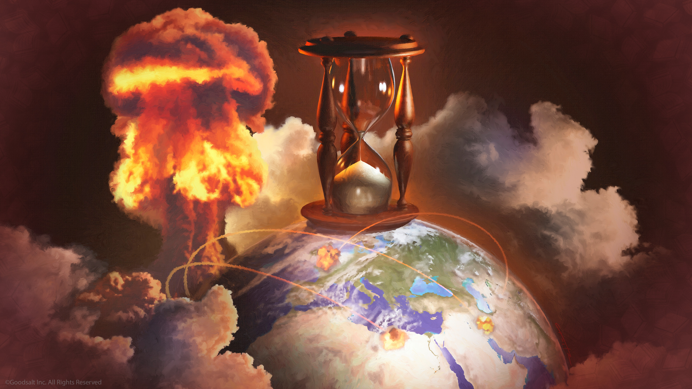
Notes:
Another good reason for us to trust that the Bible is truly inspired by God is its ability to foretell the future.

Slide 46
Notes:
The the book of Isaiah are found these words: “I am God, and there is no other, declaring the end from the beginning,

Slide 47
Notes:
… and from ancient times things that are not yet done.” (Isaiah 46:9, 10).

Slide 48
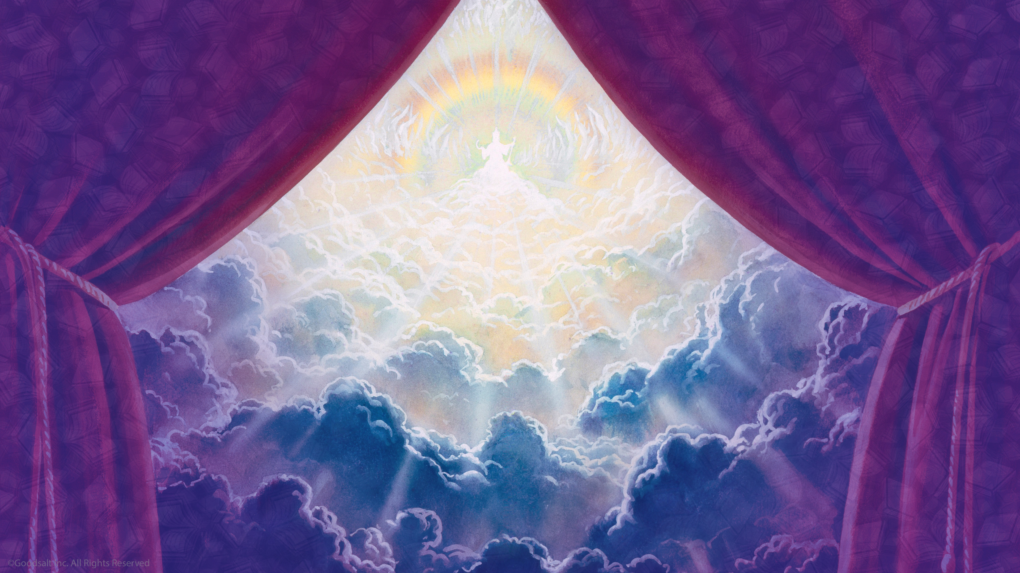
Notes:
As God pulls back the curtain of time, revealing events far into the future, He shows us that the Bible is not just another book. Only He can reveal the future!

Slide 49
Notes:
Before Babylon had even become a great nation, God’s Book predicted its fall. “And Babylon, the glory of kingdoms, the beauty of the Chaldeans’ pride,

Slide 50
Notes:
…will be as when God overthrew Sodom and Gomorrah” (Isaiah 13:19).

Slide 51
Notes:
The Bible not only foretold the fall of Babylon, but it also predicted it would never be rebuilt. “It will never be inhabited... but wild beasts of the desert will lie there... and their houses will be full of owls”. (Isaiah 13:20, 21).

Slide 52
Notes:
The explorer, Austen Layard, describes the site of ancient Babylon as he found it. “Shapeless heaps of rubbish cover for many an acre the face of the land... a naked and hideous waste.

Slide 53
Notes:
Owls start from the scanty thickets, and the foul jackal skulks through the furrows.” (Discoveries Among the Ruins of Nineveh and Babylon, p. 413.)

Slide 54
Notes:
Perhaps the greatest evidence that the Bible is true is how God uses the Bible to change lives. The main message of the Bible is that God gave His son, Jesus, so that we might be saved. In the pages of the Bible is the story of how He has overcome Satan and death, and how He can give us a new life of victory over our natural selfishness.

Slide 55
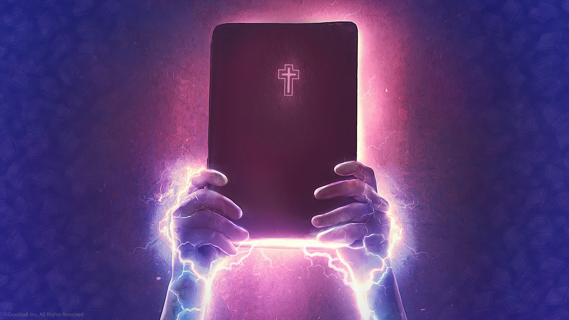
Notes:
God uses the words of the Bible to change our lives, change our human character, give us help when we are weak, and courage when we are sad. The Bible tells us that we have hope for the future. That is why it is called the “living” Word of God (Hebrews 4:12).
When we read the Bible and hear God’s message for us, our faith in Him is strengthen. And through this faith we begin the new Christian life.

Slide 56
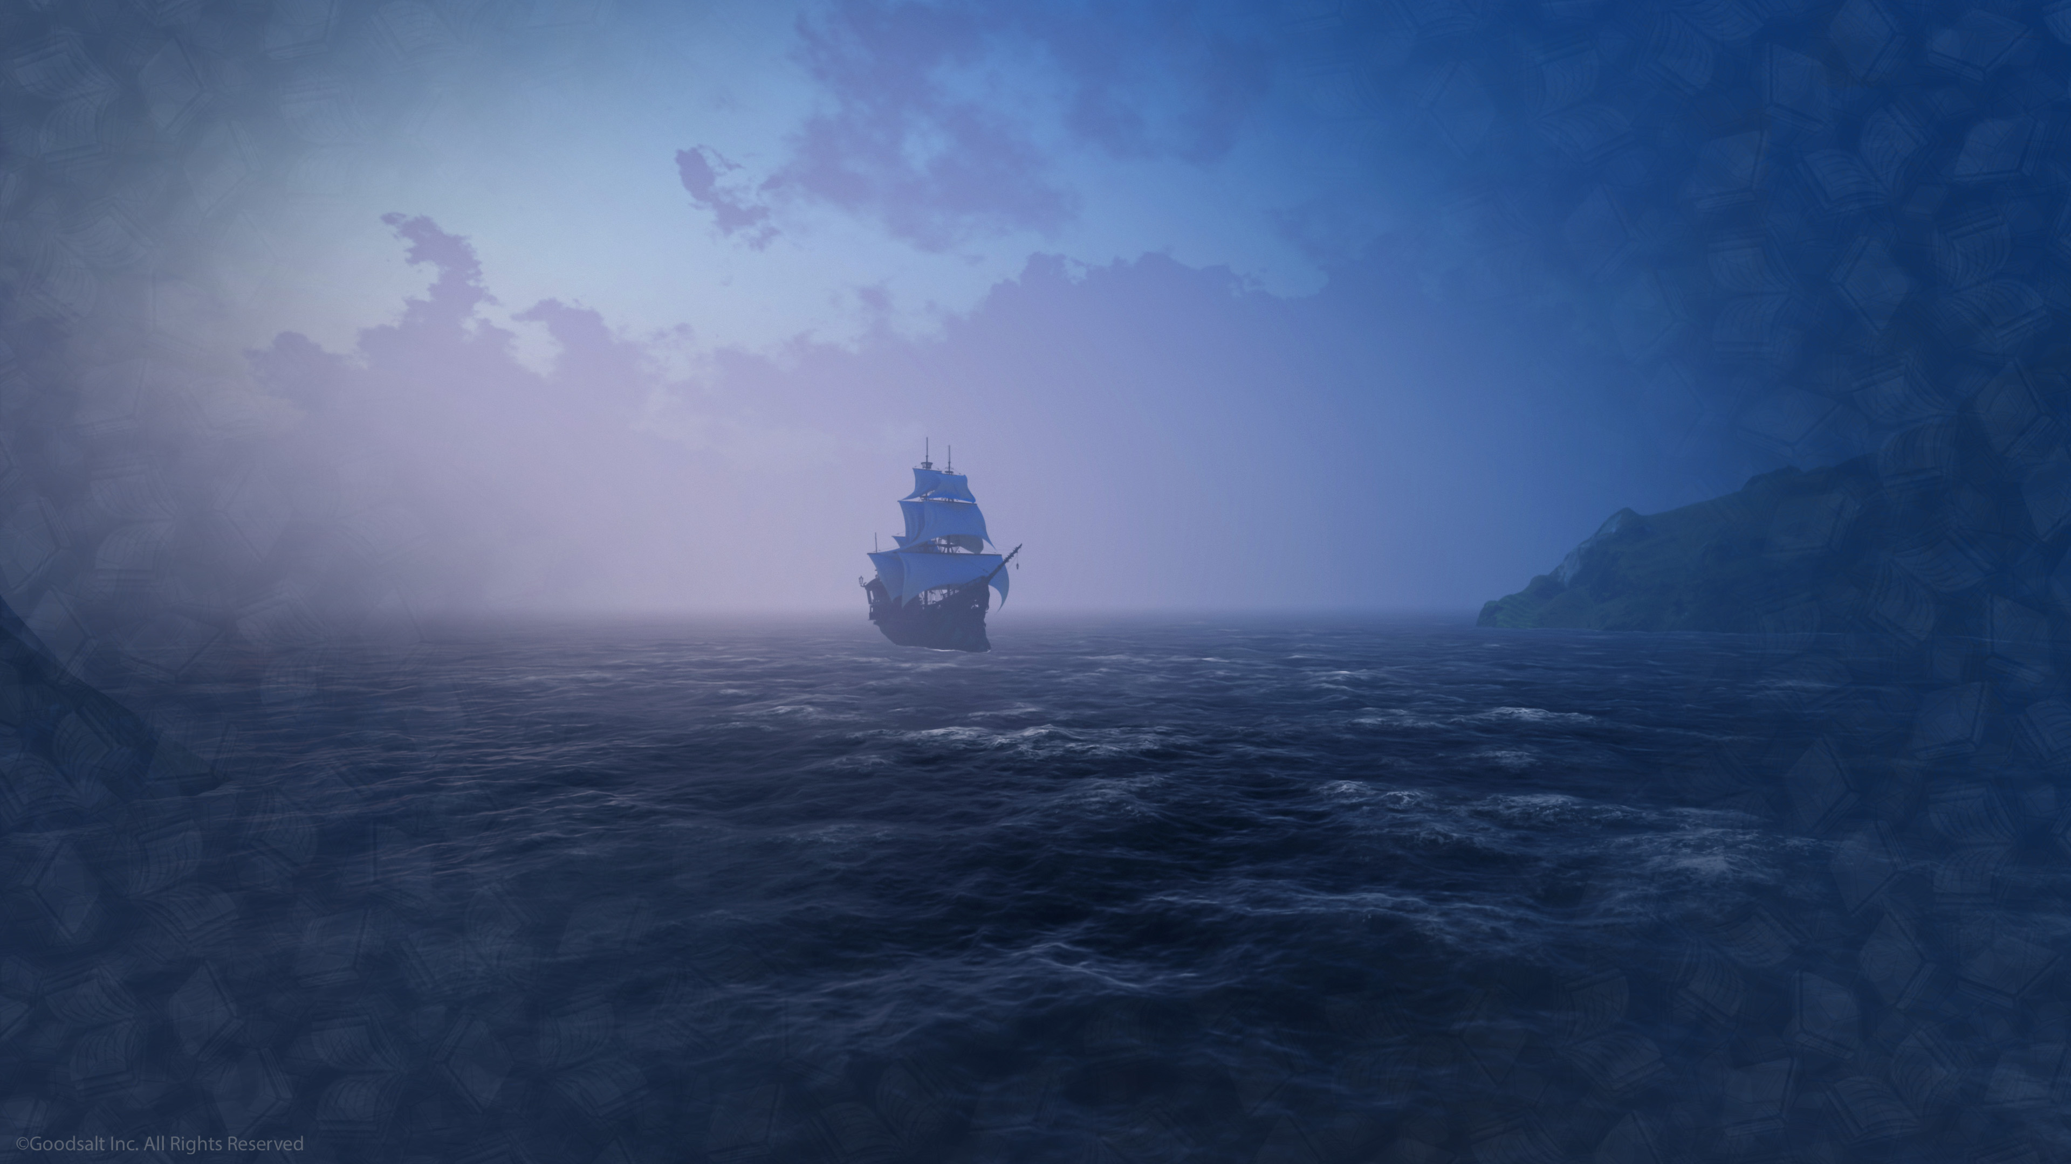
Notes:
Let me tell you a true story that is an example of how the power of God’s Word, the Bible, is able to change lives. Many years ago, there was a ship called the Bounty. In 1790, the Captain and his crew started out from England to make money in through trading.

Slide 57
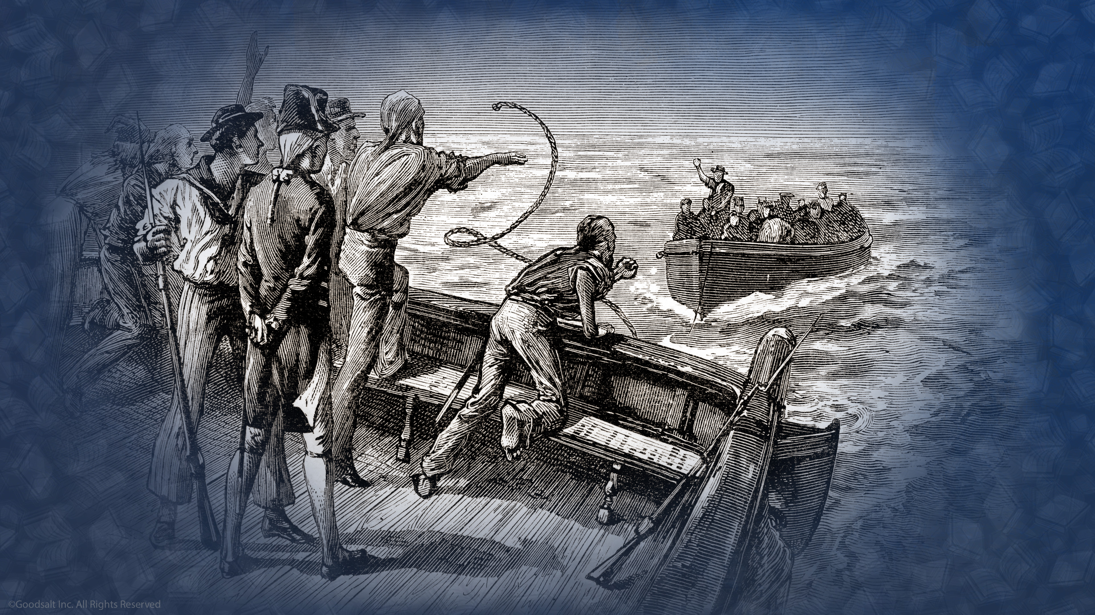
Notes:
Because of Captain Bligh’s cruel leadership and mistreatment of his crew, there was a mutiny. A mutiny is when the sailors take away control of a ship from its captain. The leader of the mutiny, gave the Captain and eighteen of the crew a small boat and sent them away. The little boat managed to find its way back to England because of the expert skills of Captain Bligh to navigate.

Slide 58
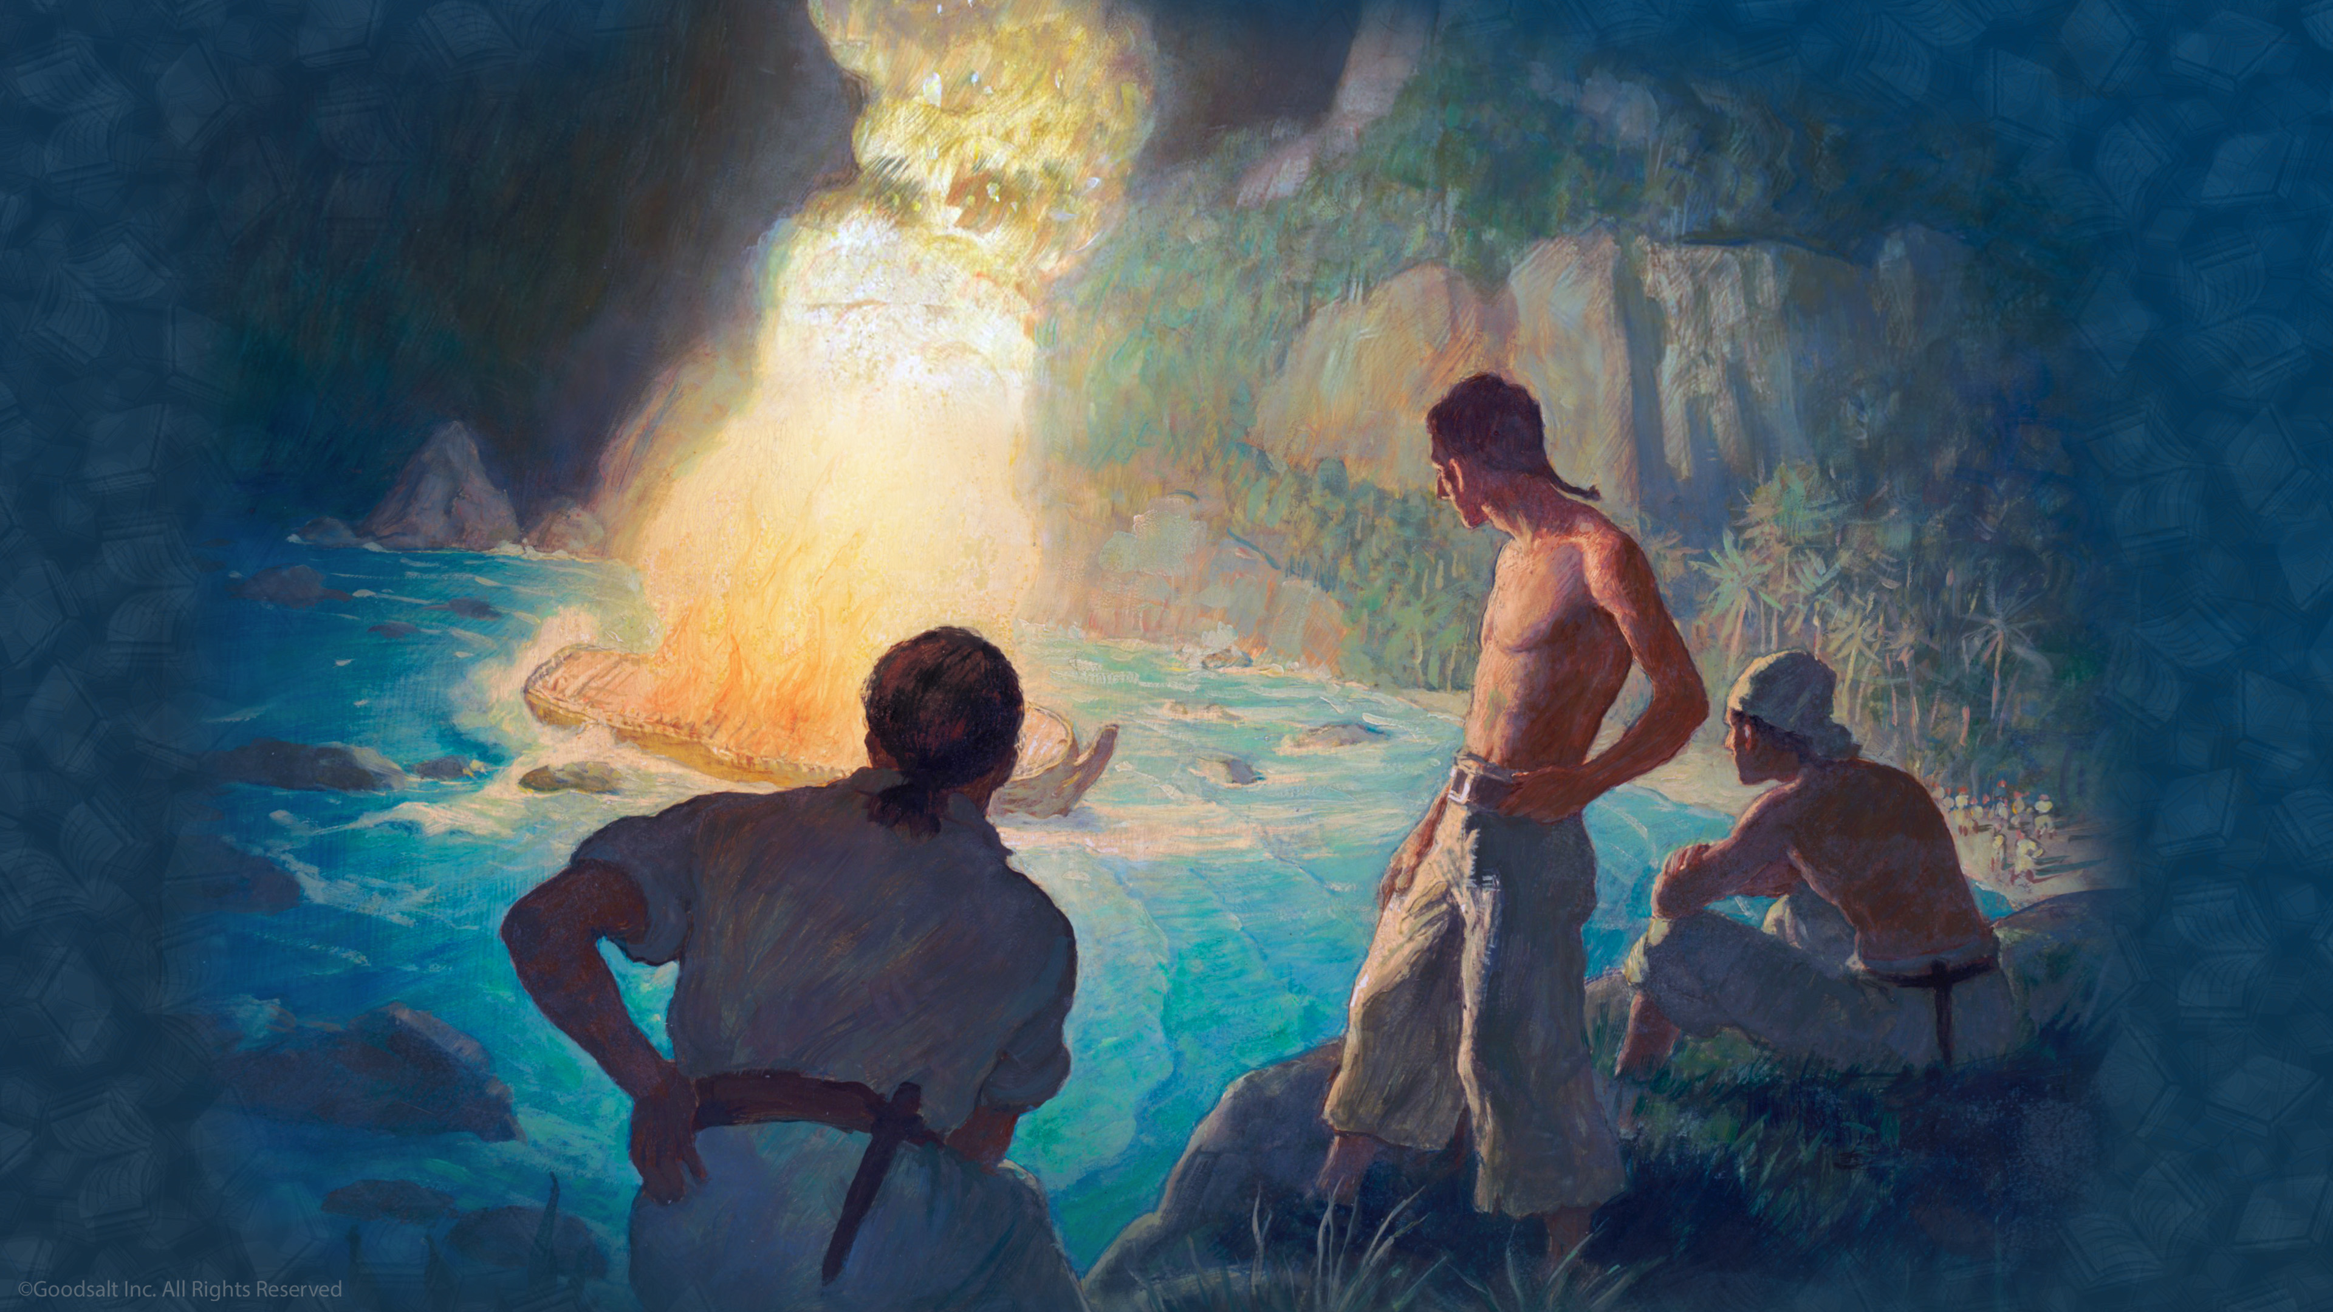
Notes:
The crew on the Bounty knew they might be caught later by the British navy and probably be executed. So they tried to find a place to hide. They ended up on a remote uninhabited island called Pitcairn. Included on board their ship were a number of women and children. They burned the ship so that there would be no evidence of their mutiny.
Trouble followed the mutineers as they learned to make liquor. There were murders and crimes, and before long, there was only one man left, John Adams, and a number of women and children.

Slide 59
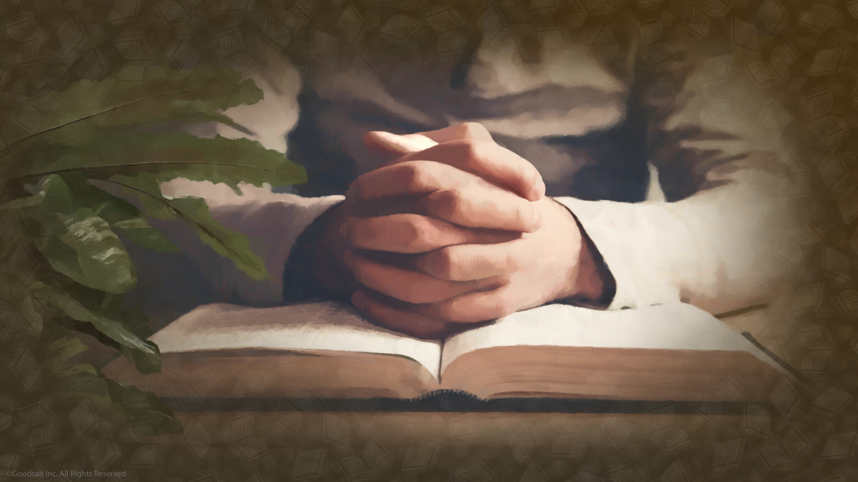
Notes:
John Adams had been a Christian when he was a little boy. He searched until he found the ship’s Bible which had been stored away in a chest. He started reading it, and as he did so, a great change came over him.

Slide 60
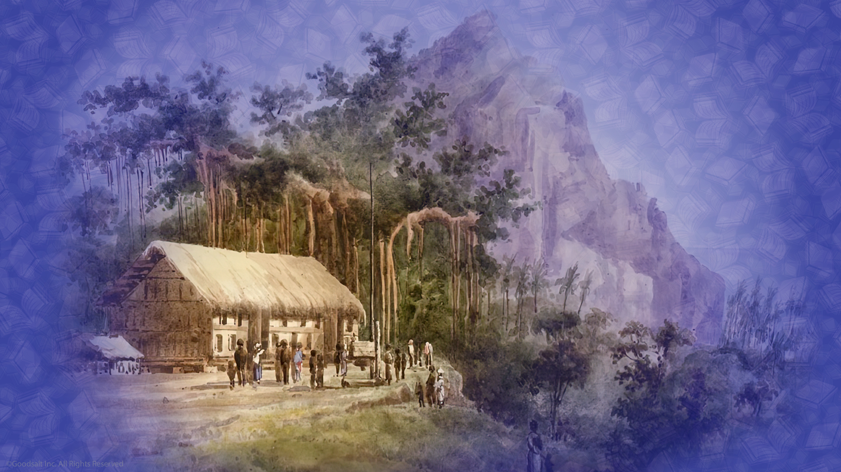
Notes:
He realized that an important responsibility had come to him to provide a future for these children. He began to educate them on how to read and write and how to live. He read the old Bible to the women and children. There was an amazing transformation in the entire population of the island and this attracted the attention of passing ships that had discovered Pitcairn Island. Eventually the whole world heard about how the Bible had saved this little group of people.

Slide 61
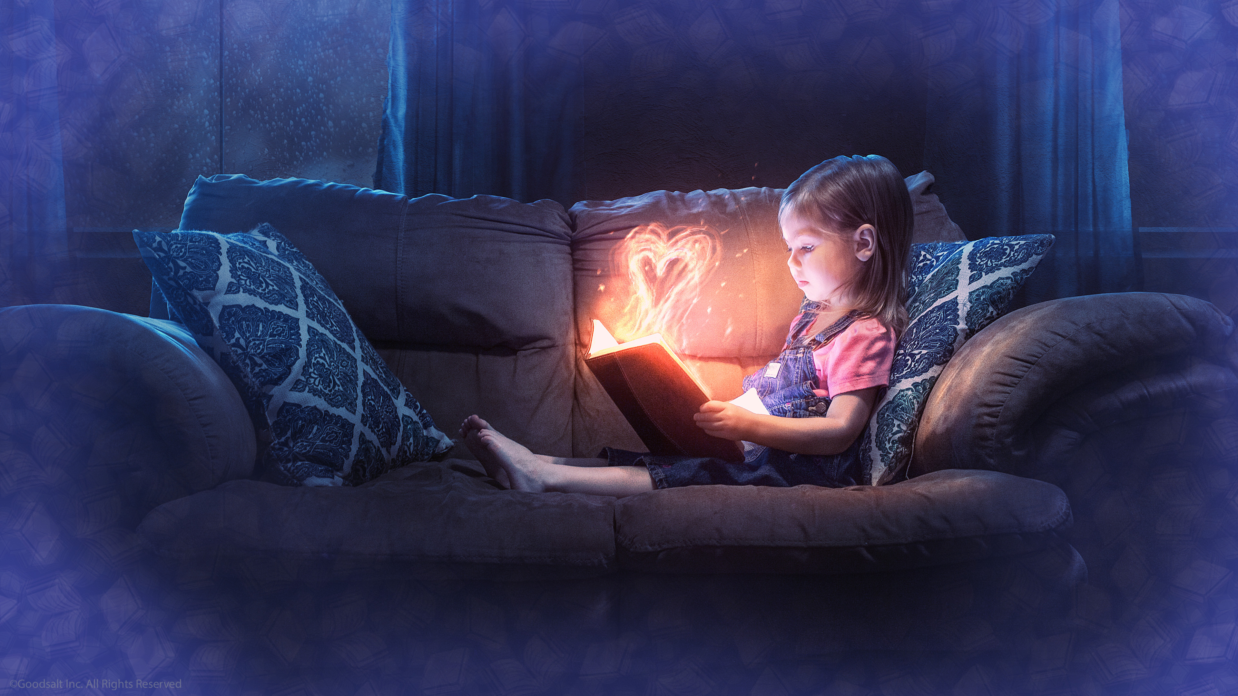
Notes:
The Bible can change our lives, too. It shows us how much He loves us. When we read the Bible, the same Holy Spirit which inspired the Bible writers to write down God’s Word centuries ago, transforms our lives as we study it today.

Slide 62
Notes:
This is the wonderful truth about the Bible. First God inspired a prophet to write down His message. Then that message is miraculously preserved and protected by God down through the centuries so that we can read it today. Then as we prayerfully open the Bible the Holy Spirit uses His power to help us understand the messages of the Bible.
What an amazing book. No wonder it is called the Word of God!

Slide 63
Notes:
[Suggested Prayer] “Father in Heaven, thank you for giving us this wonderful Book, the Bible. Thank You for giving us Jesus to help us understand how You want us to live. Help us to follow Your Word, even when it calls for us to change our ideas or activities. Today we ask that your Holy Spirit help us to understand your amazing book. We pray, in Jesus’ name, Amen.”

