Slide 2
Notes:
It’s Good to Know the Judge [presentation time approximately 20-30 minutes]
Welcome boys and girls!
Today we are going to discover how God will judge the world, and how we will experience that judgment.

Slide 3
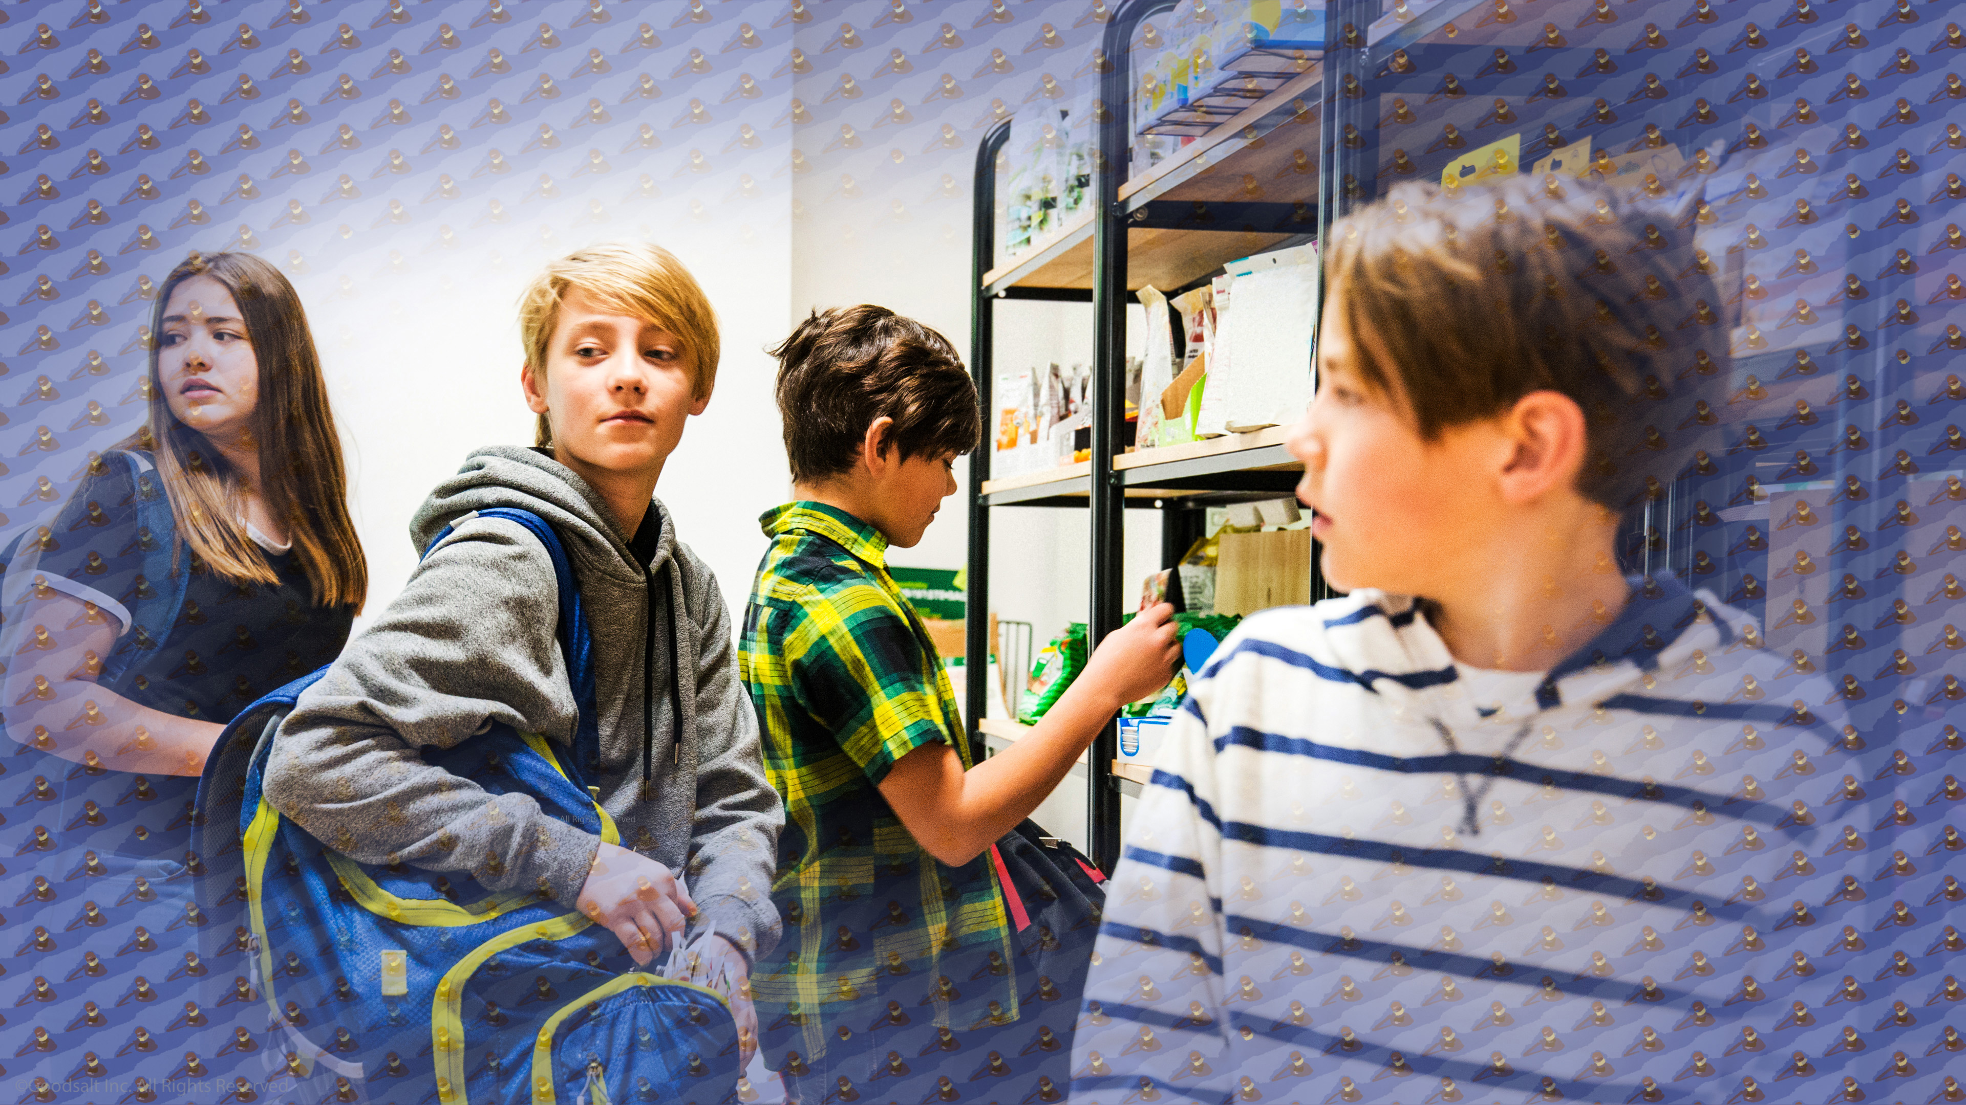
Notes:
Have you ever wanted to do something that your feelings told was OK, but your head told you it was a bad idea?
Maybe it was taking something that belonged to someone else. Maybe it was joining some friends who were sneaking some snacks from a convenience store without paying for them. Perhaps in your mind you said, “Who’s it going to hurt? This store makes so much money off people, it won’t matter!”

Slide 4
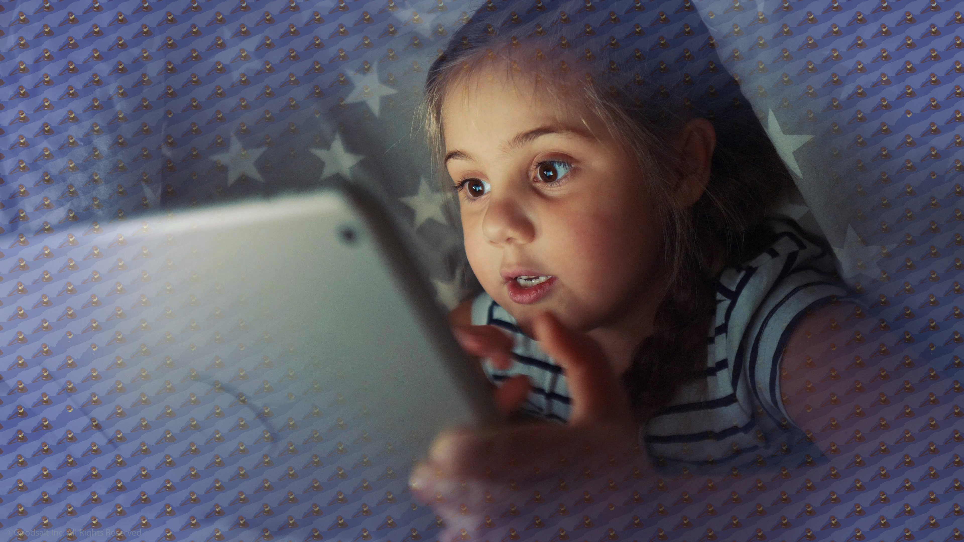
Notes:
Or maybe you decided to look at something your parents told you was not right to watch on your computer, tablet, or phone. But your parents were asleep or away, and they were not paying attention to you. Maybe they never found out what you watched.

Slide 5
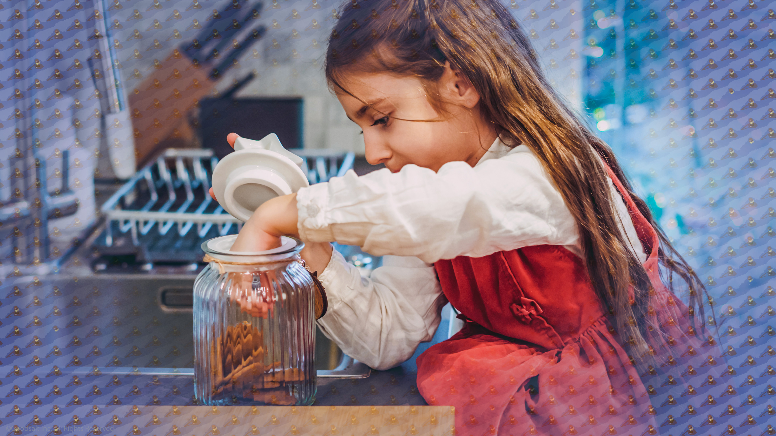
Notes:
If you do something you have been told is wrong, but nobody catches you, is it still wrong? If nobody sees you take the cookie you were told not to take, is it OK because you did not get caught? And what about others? If the police do not catch a driver who is speeding in a car, is that person not guilty of speeding?
Can you get in trouble and avoid judgment if you are never caught?

Slide 6
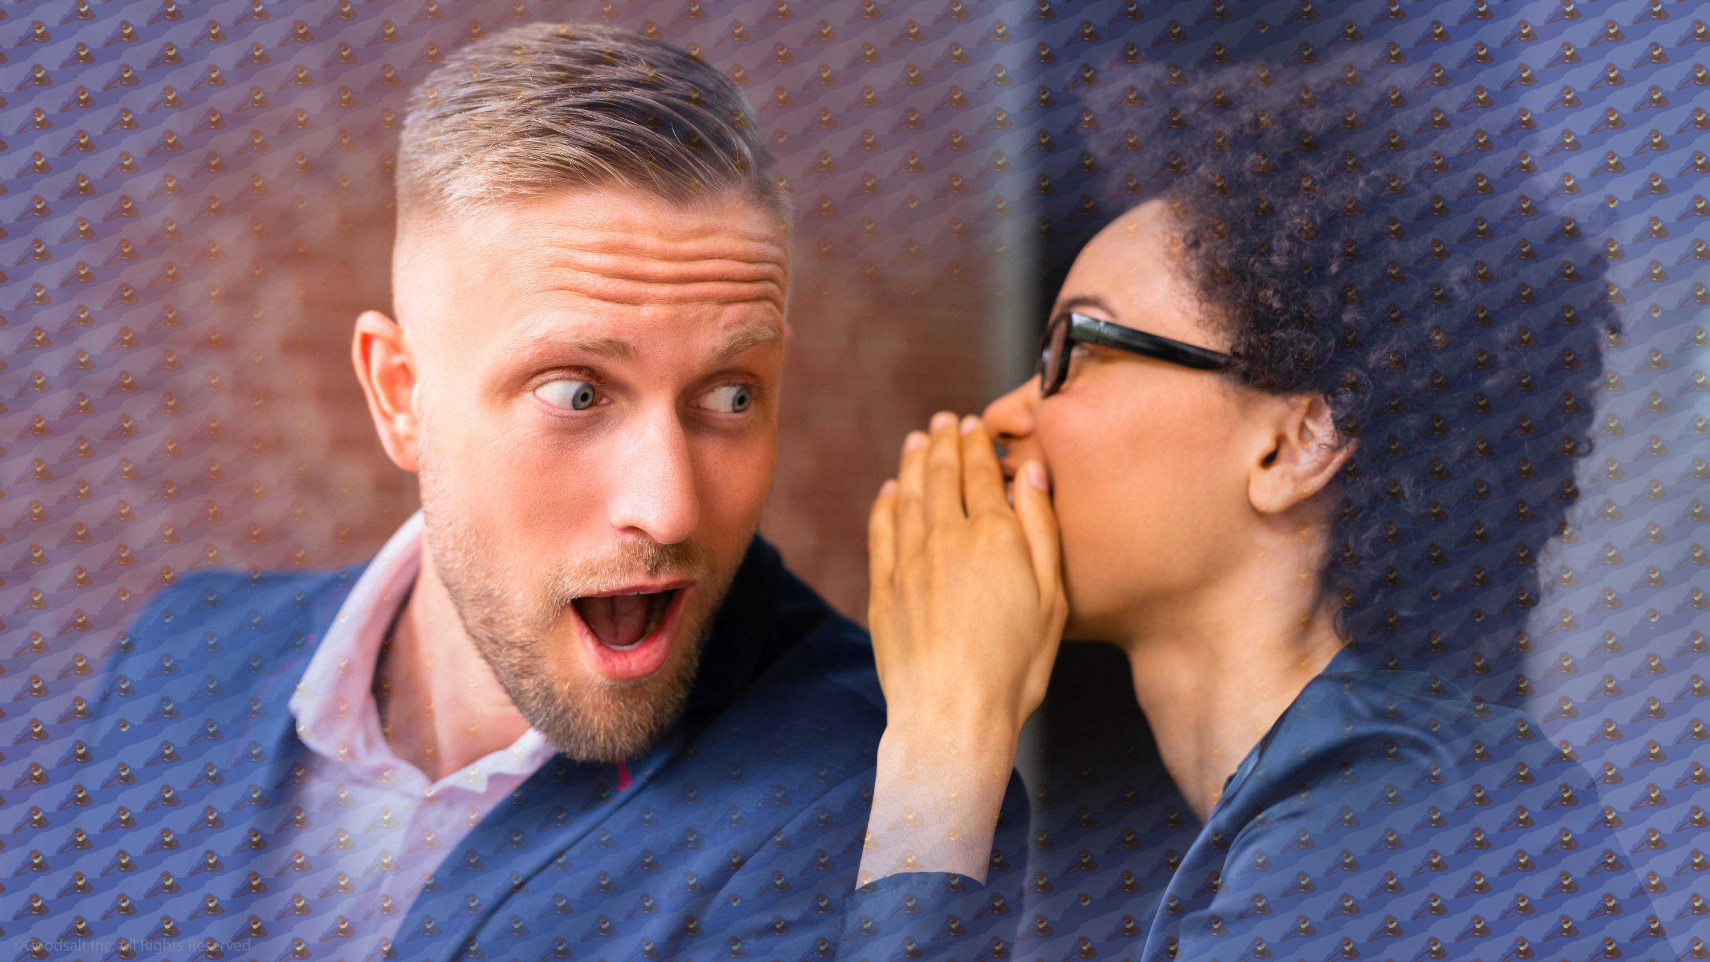
Notes:
People do and say things when they think nobody is watching. Gossiping is a good example. Would they say the same thing if the person they are gossiping about could hear what they were sharing? Of course not! And most of the time the victim of the gossip never finds who was gossiping about them.

Slide 7
Notes:
The Bible teaches us that God is always watching us, and He notices all we do and say. Even the thoughts that we secretly think and feel. The prophet wrote “For God will bring every deed into judgment, including every hidden thing, whether it is good or evil.”

Slide 8
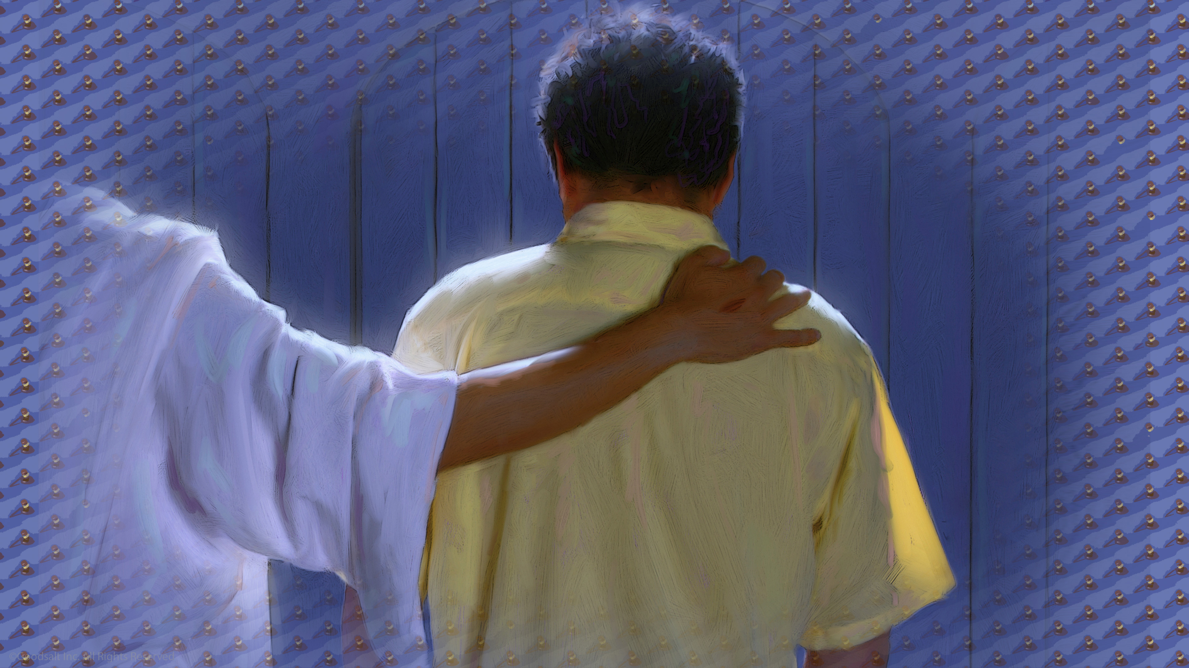
Notes:
The word Judgment might seem like a scary word, but when we read the Bible we learn that Jesus is our Judge. “For the Father judges no one, but has committed all judgment to the Son…” John 5:22
Judgment is not something to fear if Jesus is our Savior and Lord. In God’s court Jesus is on our side.

Slide 9
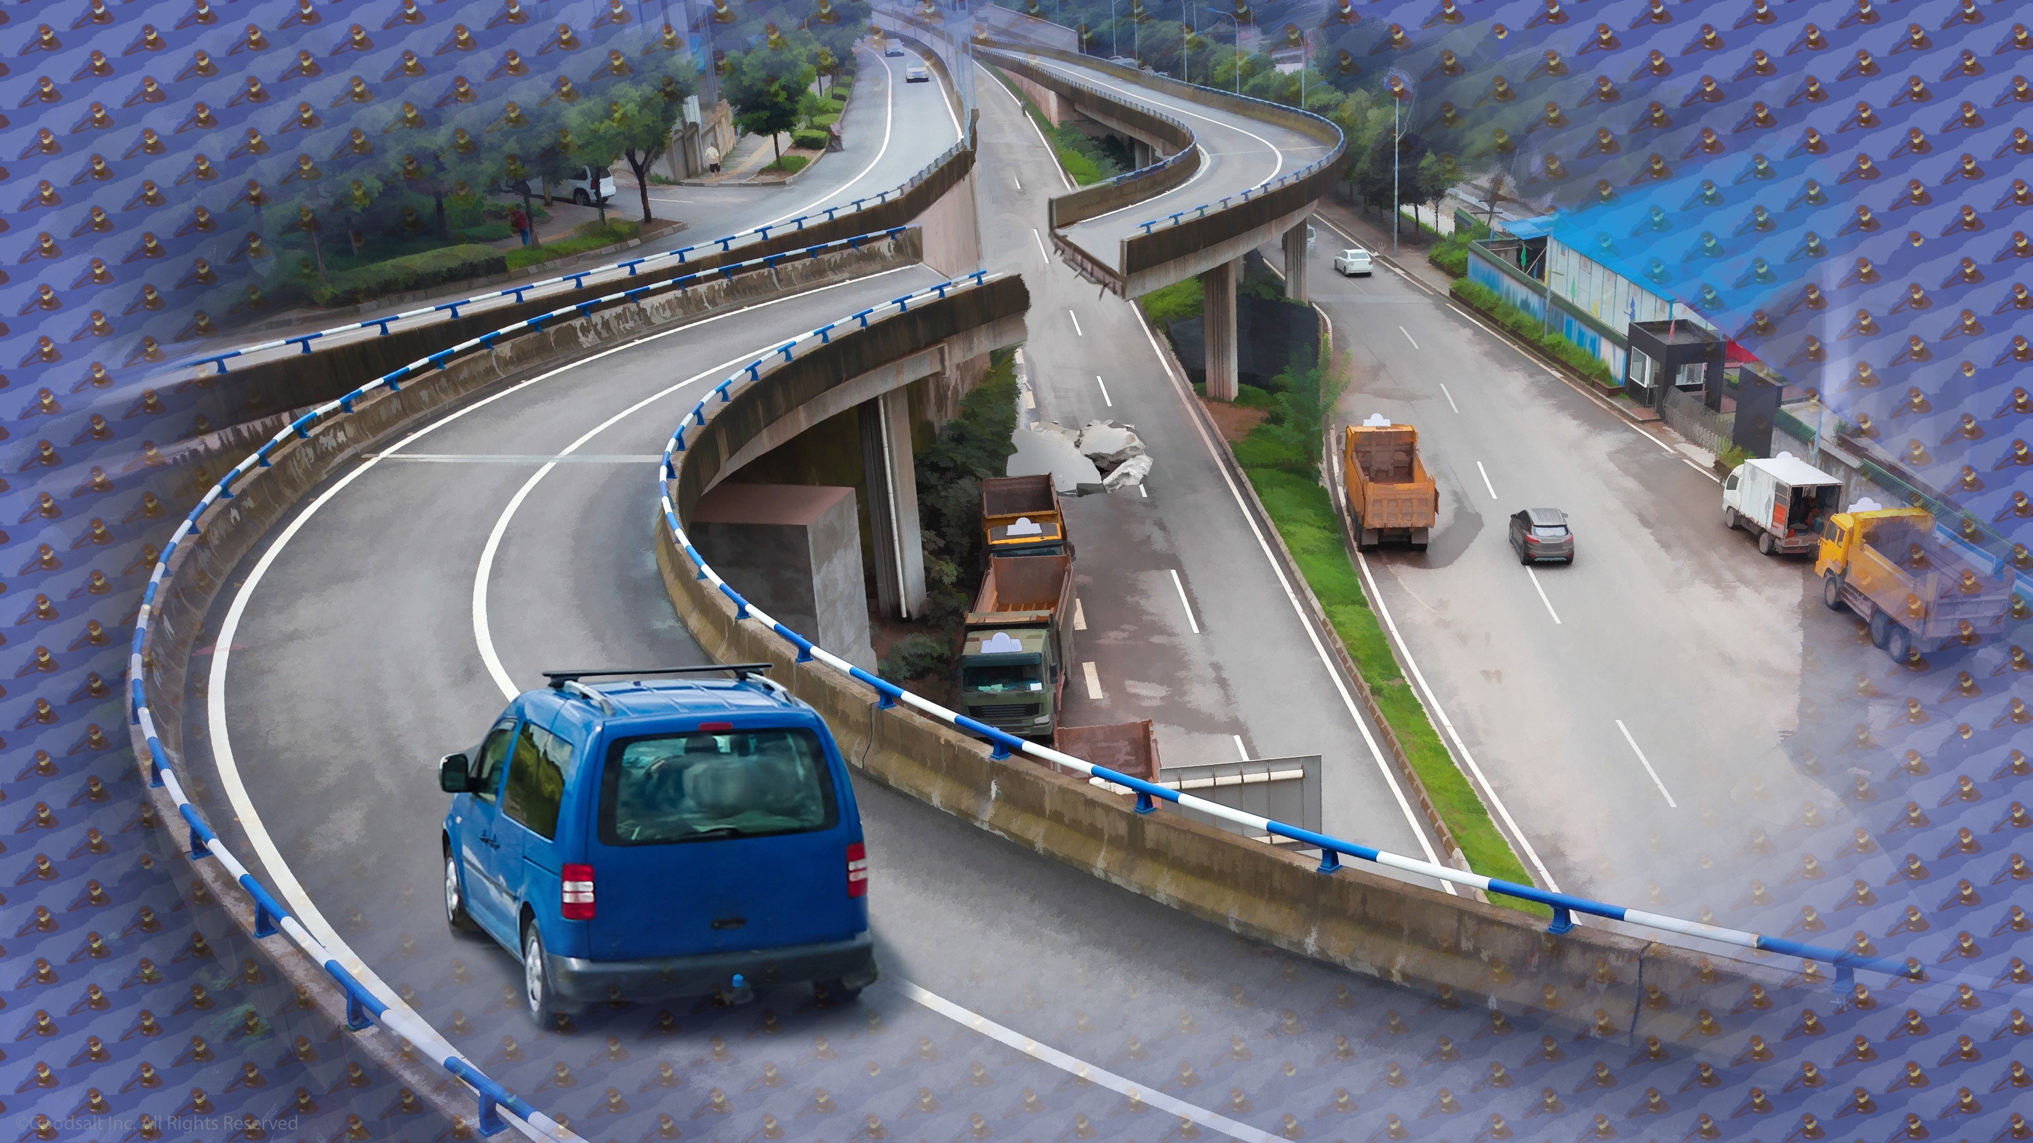
Notes:
The universe could not exist without laws. Laws make the world fair and safe. Without laws, life is dangerous and people don’t know what direction to go.
You may be traveling in a direction that looks right to you, but you may not realize you are about to drive straight off a collapsed bridge! You may not realize it, but God does.

Slide 10
Notes:
Jesus knows everything. He created us and cares for us more than we can imagine. Because He knows us so well, He created laws based on love that He asks us to follow.
But in the end, the choice to obey is still ours to make. Jesus never forces anyone to make choices they do not want to make.

Slide 11
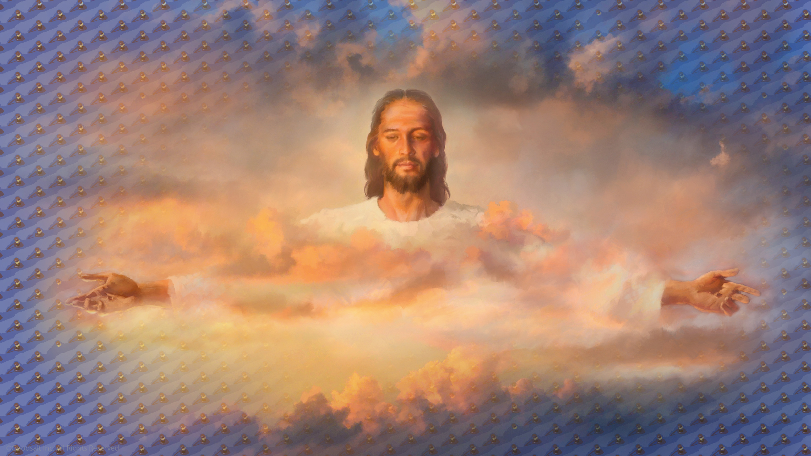
Notes:
God can see all the problems someone faces and understands why they make the choices they make. That does not mean He agrees with all those choices, but He knows why people do the things that people do.

Slide 12
Notes:
But we are not like God. We cannot see into the minds of people. We do not know what the life of a person has been like, or what sad events they have had. That is why we must not judge other people. We must leave the judging to Jesus.

Slide 13
Notes:
Imagine if you went to a zoo, and there was an enclosure with some water and land, and a little burrow next to the water. You can see some fur and a flat tail sticking out of the burrow. Do you all know what animal it is? Right, I would have guessed it was a beaver, too. Everyone knows that beavers have fur and a flat tail.

Slide 14
Notes:
But when the animal suddenly turns around and comes out of the burrow, we are surprised! It’s a platypus! In the same way we can only see part of how other people live. We may think we know what their lives are like, but in most cases we are probably wrong.

Slide 15
Notes:
The Bible says it this way,
“For man sees the outward appearance, but the LORD sees the heart.” I Sam 16:7 That is why Jesus can be such a fair judge. He knows who people really are inside and out.

Slide 16
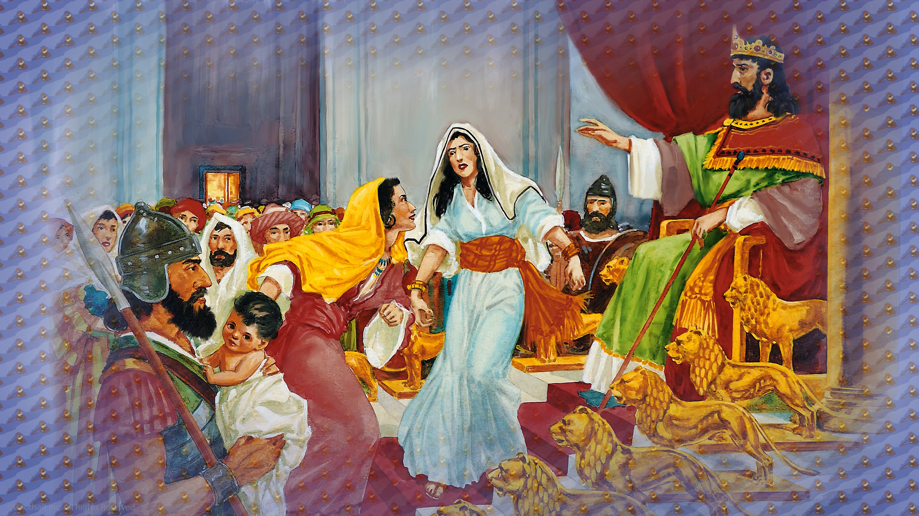
Notes:
Being a judge is not easy. The great King Solomon showed us what a wise judgment is.
One day the King was doing his job as His nation’s judge when two angry women were brought before him. They both demanded justice. They both claimed the same baby was theirs! What no one knew was that the mothers lived in the same house.
During the night one mother had accidentally fallen asleep on her baby and killed it. When she woke up and saw her dead baby, she chose to do a wicked thing.

Slide 17
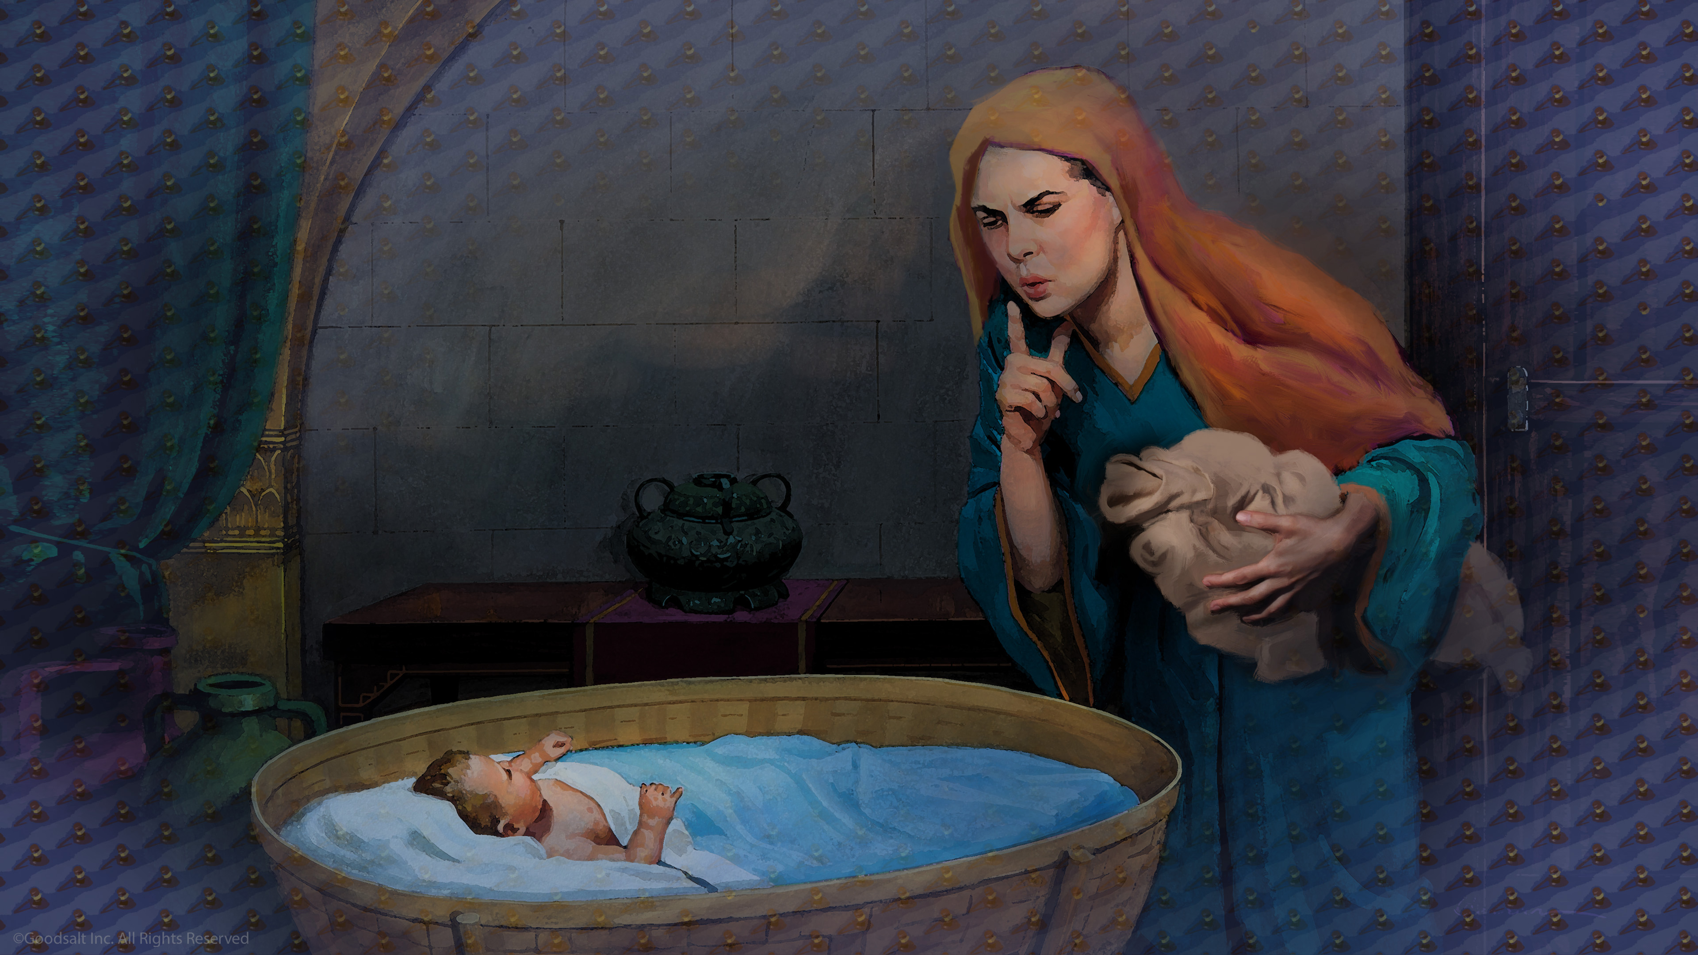
Notes:
She snuck over to the room of the sleeping mother and exchanged her dead baby for the living one. When the other mother woke up she saw what had happened.
The mother accused the wicked woman of stealing her baby but she denied it. An argument began about which baby was which. No one knew who was telling the truth so they were both sent to wise King Solomon to judge their case.

Slide 18
Notes:
What was the King to do? He did not know who the real mother was. But he had an inspired idea. He asked a nearby soldier to draw his sword.
“Cut the living child in two and give half to one and half to the other.” I Kings 3:25
He gave the order. Then he watched to see what would happen.
One woman said, “NO! Stop! Go ahead and give her the baby! Please don’t hurt him!”

Slide 19
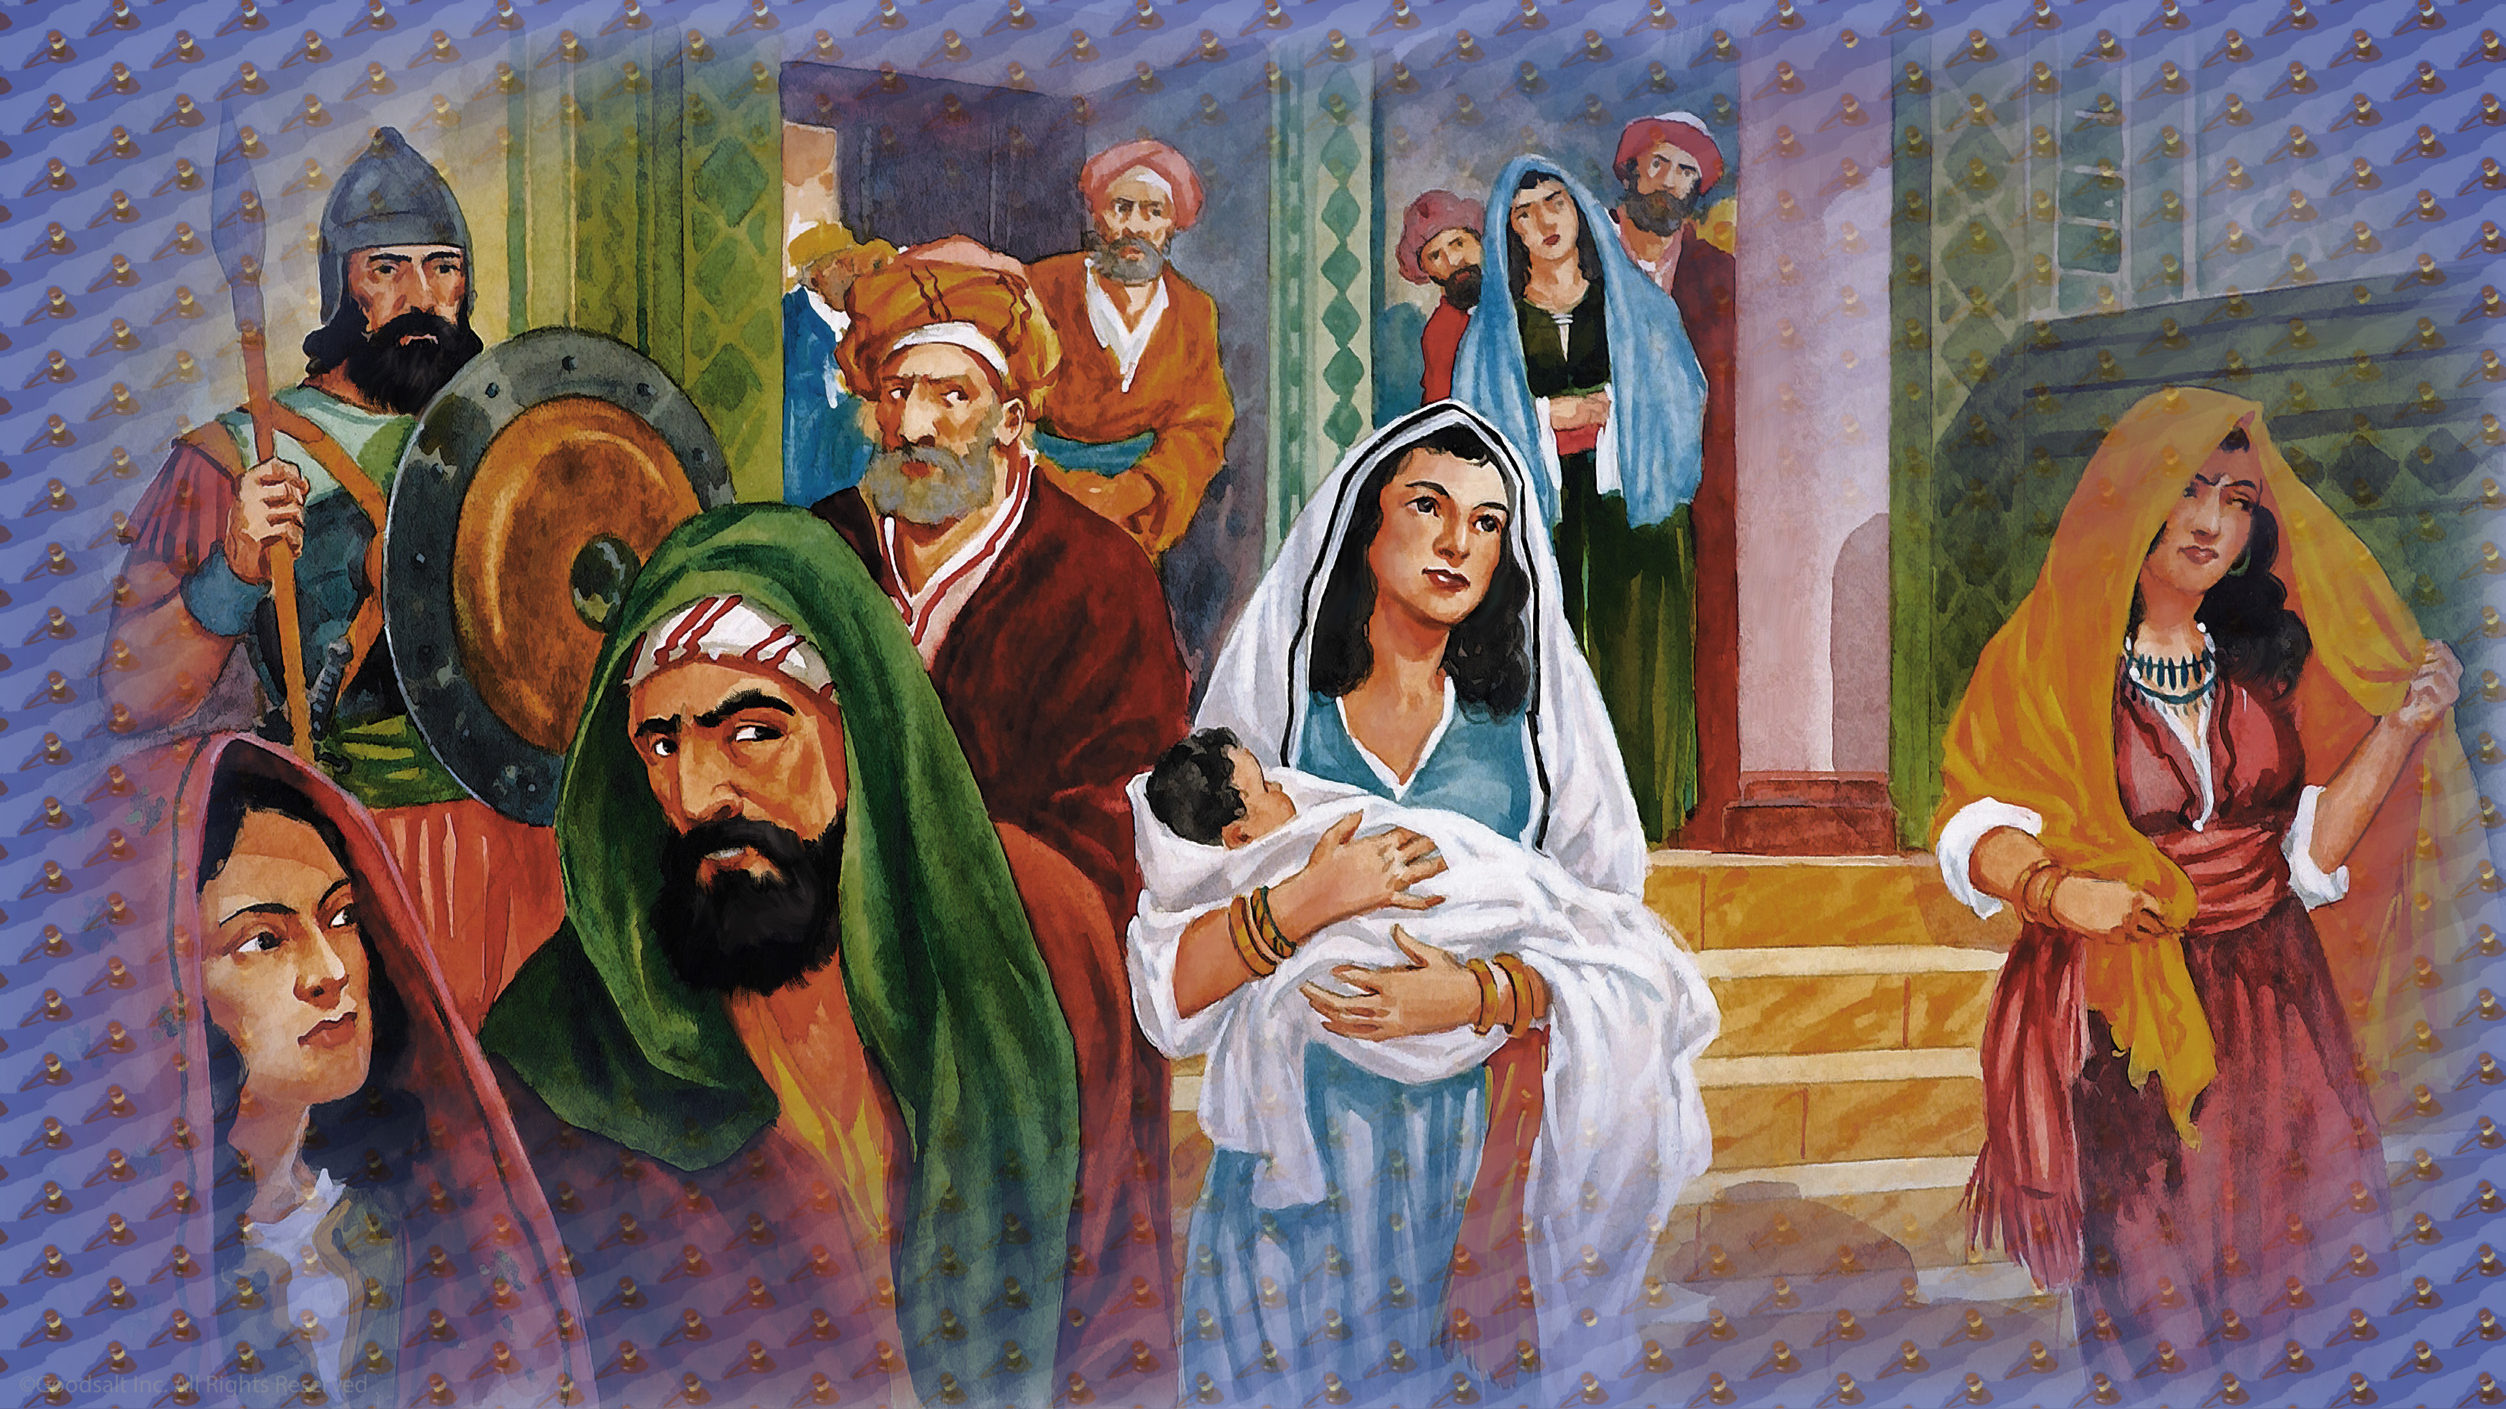
Notes:
Then Solomon knew which was the real mother, because she had pity and love for her child, even if she could not have him. Solomon declared that she was the rightful mother and gave the baby back to her.

Slide 20
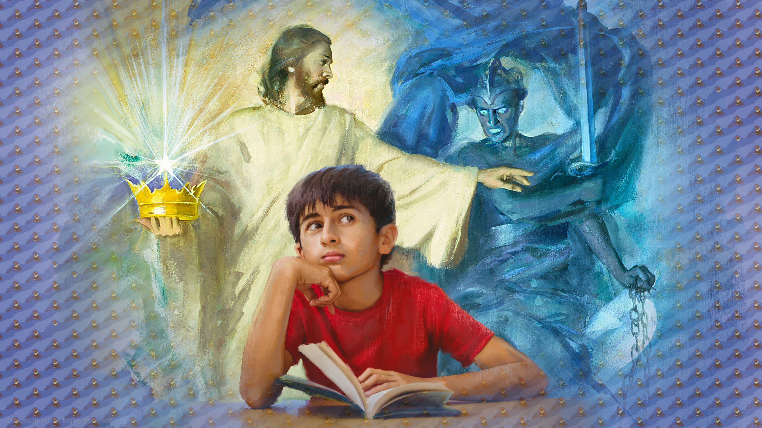
Notes:
Solomon’s wisdom came from God. Jesus can see us very clearly and understands us like no other. And He is like that kind mother, who only wants us safe. Lucifer is like the selfish, wicked mother who hates us and only cares about his own selfish plans.

Slide 21
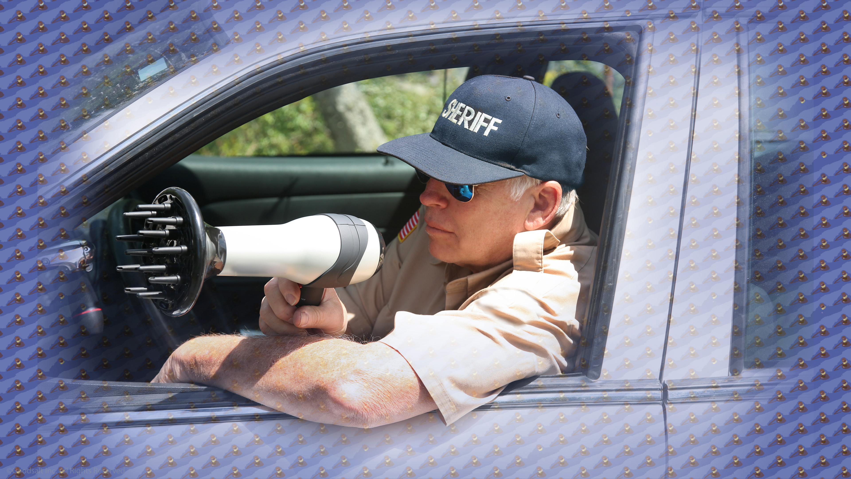
Notes:
Now some people have an odd idea that God is like a bad tempered traffic officer, just sitting and waiting for people to make mistakes so he can pull us over and hand us a ticket.
But that is not what God is like at all. God wants us to make great choices and is always there, eager and willing to help us make them! All we need to do is ask for help!

Slide 22
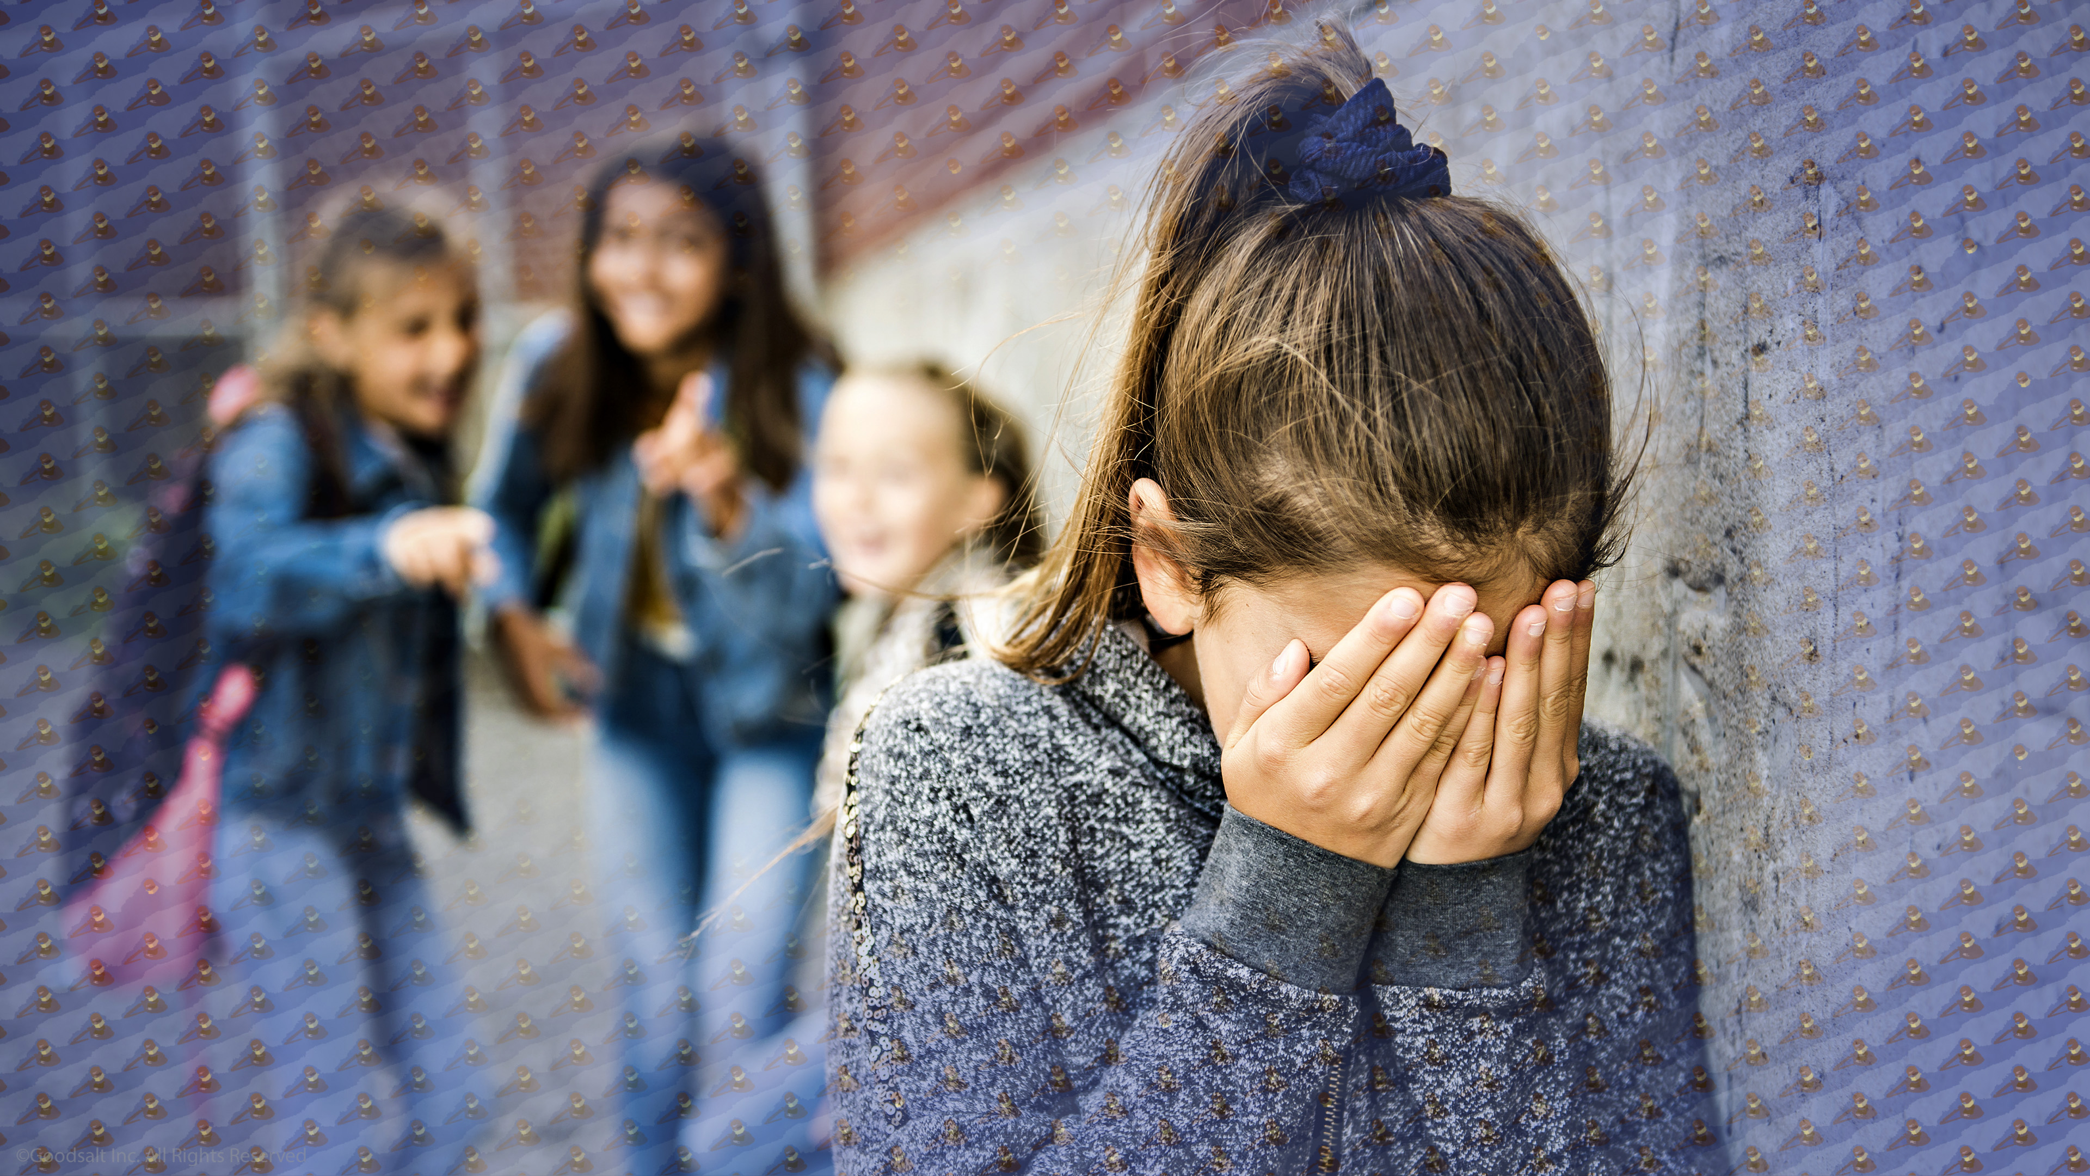
Notes:
Some people do not want help from anyone. They cross their arms and plug their ears whenever help is offered. There is something that they know is wrong but they don’t want to give it up. Maybe they like teasing and bullying, for example. God has impressed on their minds that it is wrong. But He does not force them to stop. But He keeps on speaking to their conscience.

Slide 23
Notes:
God has a kingdom He is building just for His children in Heaven, and it will be a place of such beauty and awesomeness that no-one can even imagine it.
The Bible says it this way, “No eye has seen, no ear has heard, no heart has imagined, what God has prepared for those who love Him.”
I Corinthians 2:9.

Slide 24
Notes:
God’s kingdom of Heaven will be a true paradise, but there are things God will not allow there, or it would just spoil it all. The terrible evil, pain, and suffering of this world will just be a distant memory. “Do you not know that the wicked will not inherit the kingdom of God?” the Apostle Paul asked his friends in Corinth. He goes on to list all kinds of evil that will not be allowed in God’s kingdom, like being greedy, or robbery, cheaters, or people who hurt others on purpose.

Slide 25
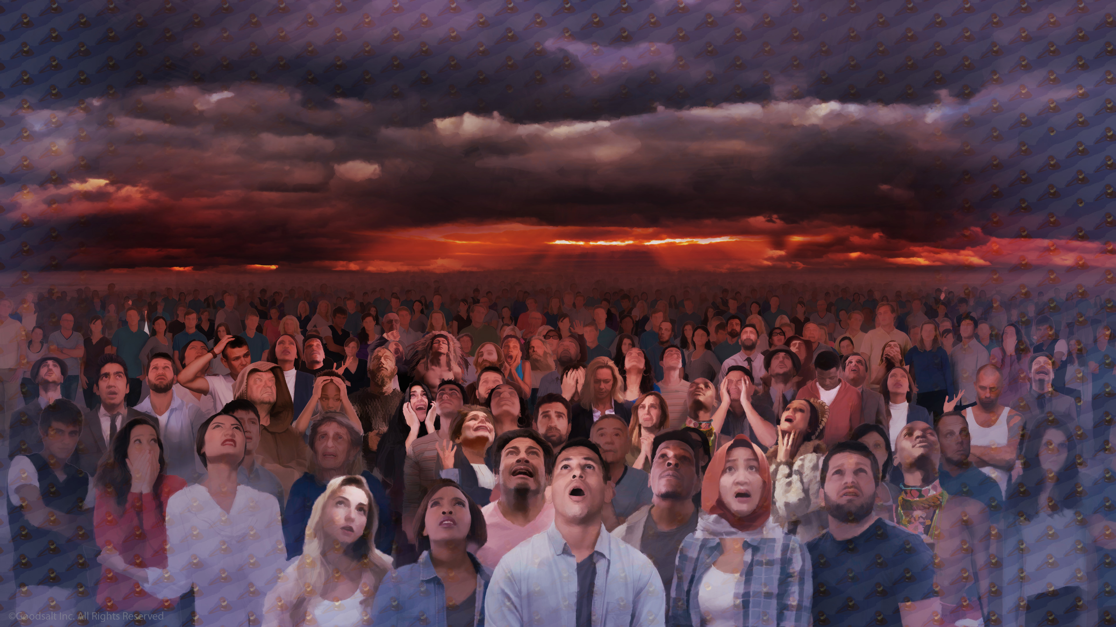
Notes:
Now, these are not people who did these things and then repented and asked God to forgive them. God always forgives us when we sincerely ask, and He always offers to help us change so that we are more like Him.
No, the wicked that are not allowed into Heaven are the people who refused God’s help and decided they do not want to change. They wanted things their way, no matter what. A record is kept of their thoughts and actions all their lives. But before we look at these records, let’s pause for a Health Gem.

Slide 26
Notes:
Today we are going to explore the most complex and amazing thing in the whole world! Can you guess what that is? Here is a hint: You are using it right now! It is the human brain!

Slide 27
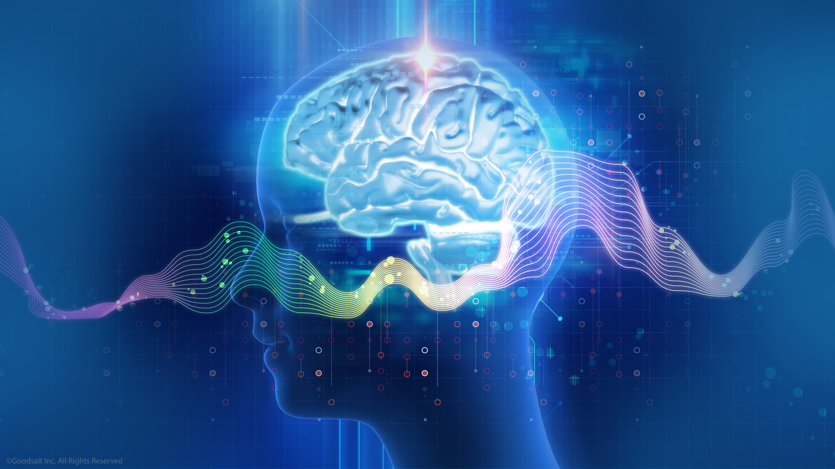
Notes:
Your brain enables you to think, learn, create and feel emotions, as well as controlling every blink, breath and heartbeat. And your brain is more complex and more powerful than the biggest computers in the world. The average brain has over 100 billion brain cells called neurons. Each neuron may be connected to up to 10,000 other neurons, passing signals to each other via as many as 1,000 trillion connections.

Slide 28
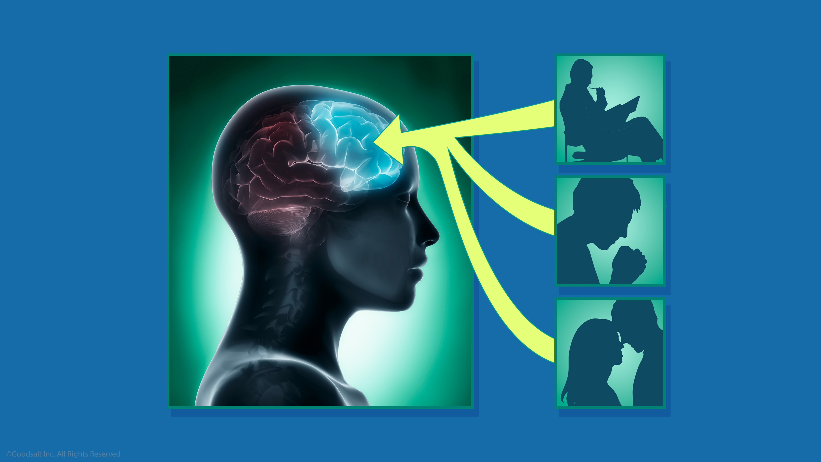
Notes:
The most important part of your brain is the section near the front of our head. Scientists call this area the frontal lobe. This is what makes us different from animals and more like God. It is where the God-given ability to make choices takes place. When you are deciding if something is wrong or right, if you choose to love and care for others, and if you are solving a problem, it is in the frontal lobe.

Slide 29
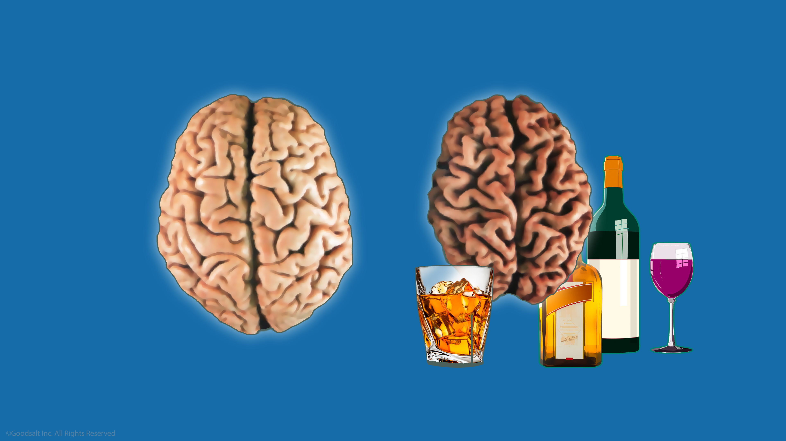
Notes:
Taking care of our brains begins with not harming it. Since our brain connects us to Jesus, Satan tries all that he can to disconnect us from Him. Satan knows how important a healthy brain is, so He tempts people to use illegal drugs that can damage the brain.
The most common dangerous drug is alcohol. Every drink of alcohol destroys brain cells. As the years of drinking go by the brain loses so many cells that it actually becomes smaller.

Slide 30
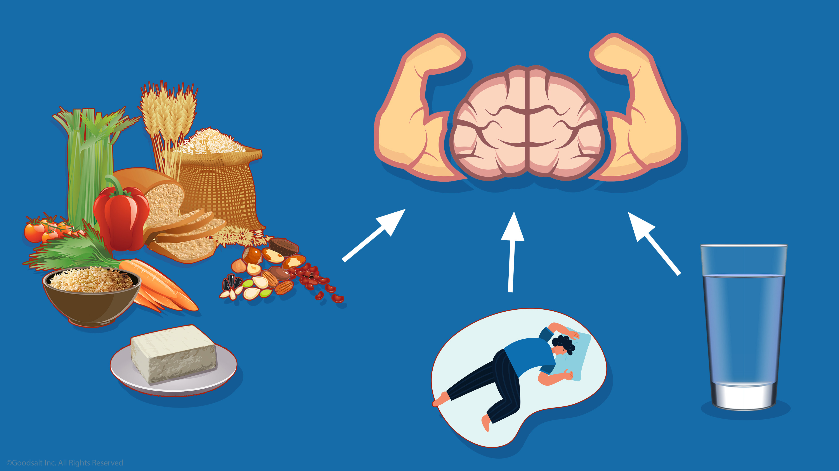
Notes:
The foods you eat are very important for brain health. Plant foods like whole grains, nuts, beans, seeds, vegetables, greens and fruit are the best foods for a sharp mind. Getting enough sleep and drinking plenty of clean water is also good for your brain.

Slide 31
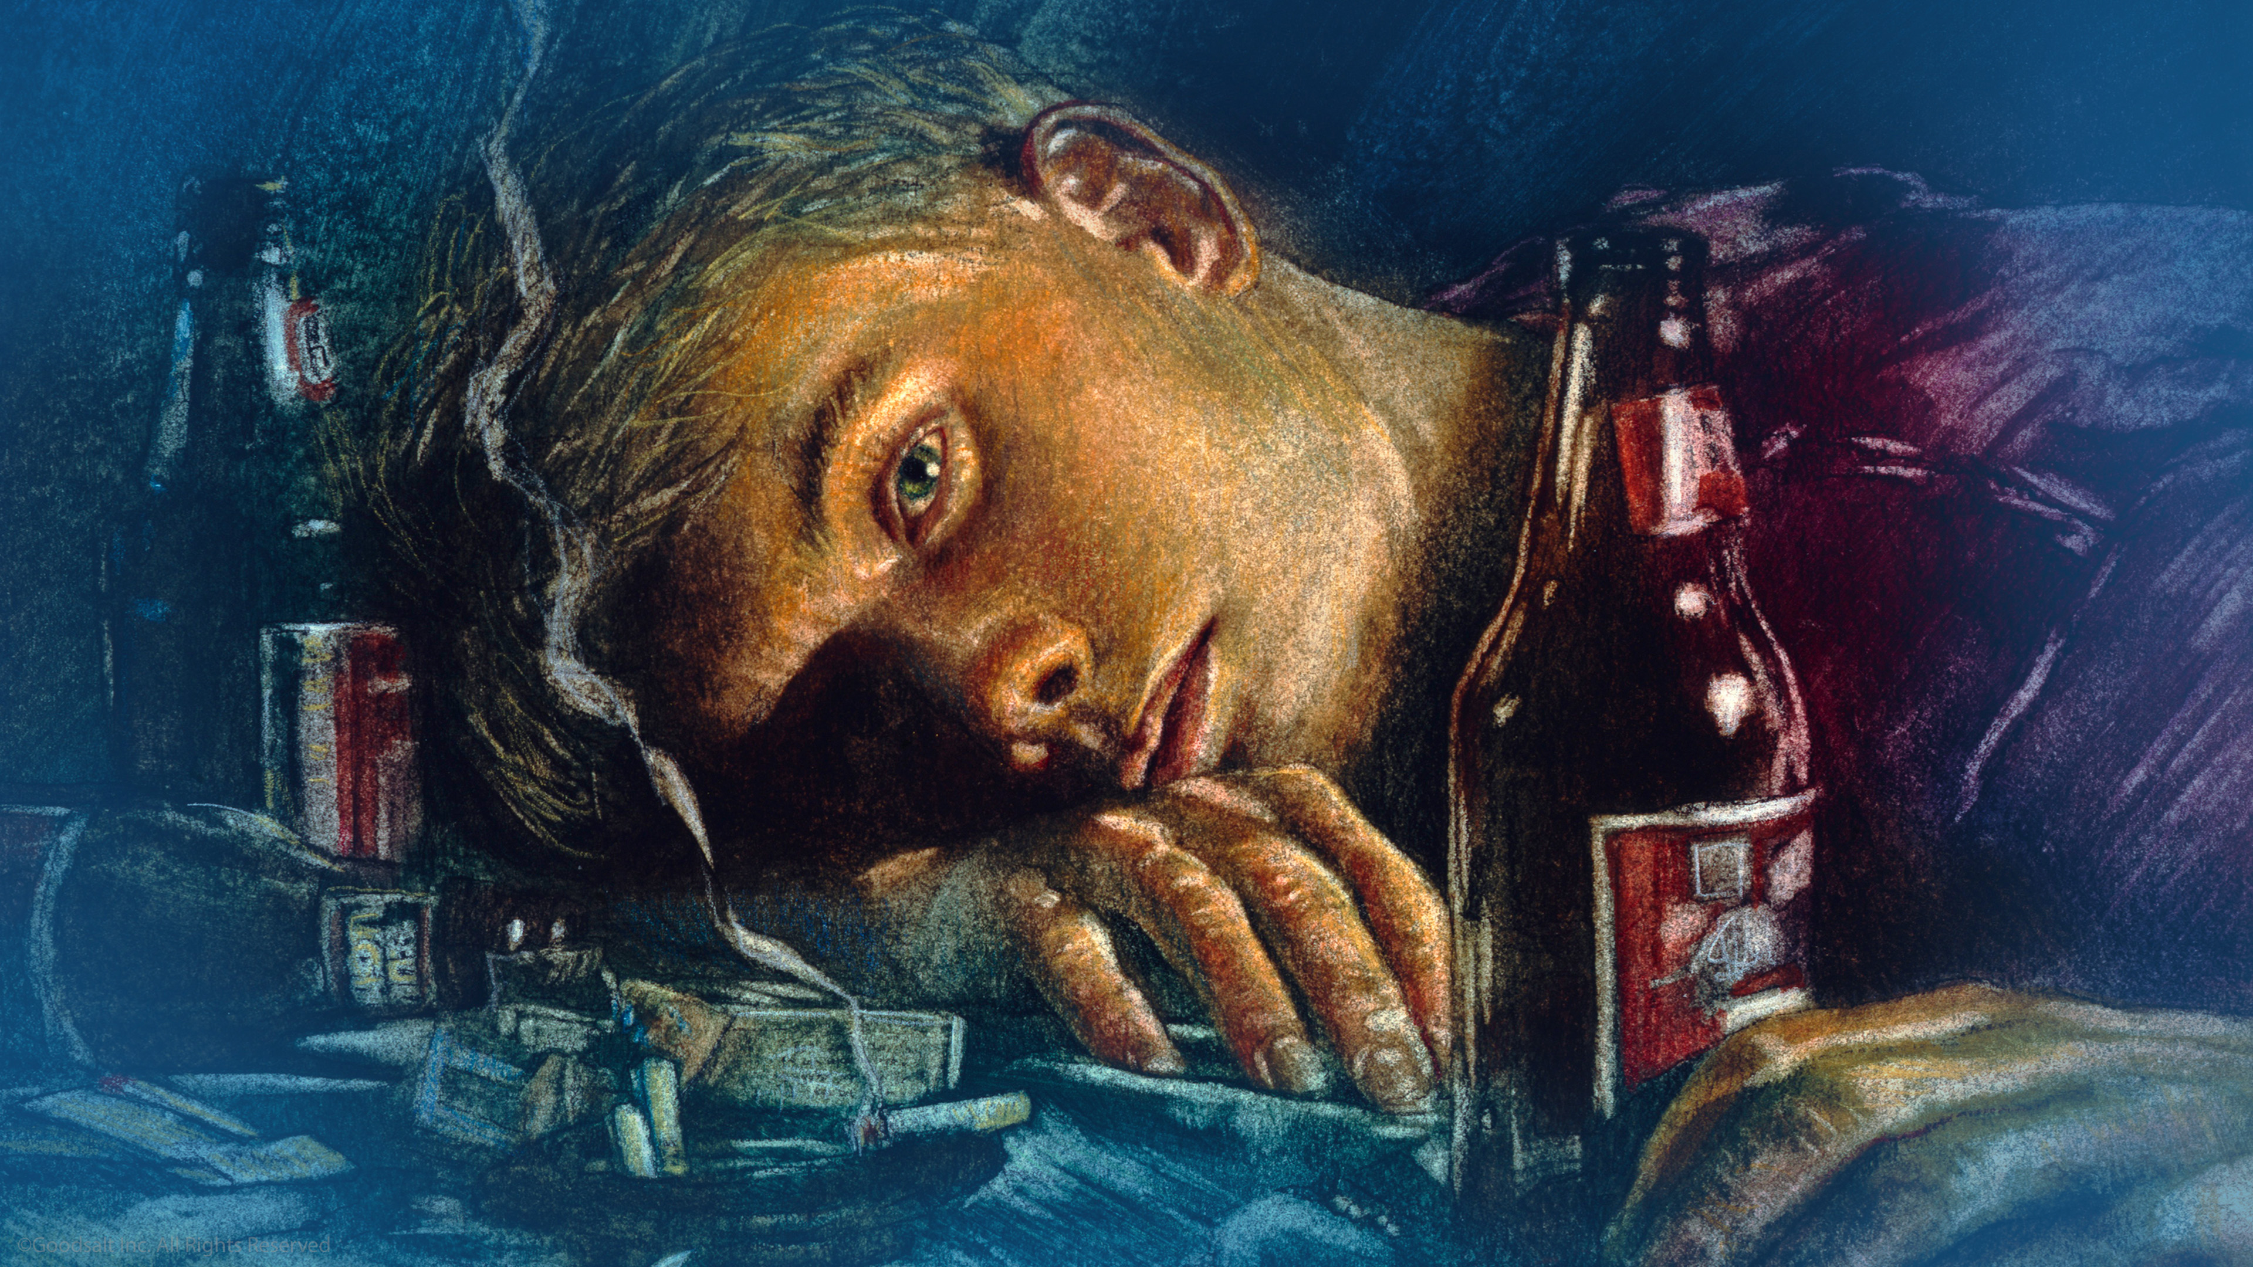
Notes:
Ever since he lost his place in heaven, Satan has hated Jesus. He wants to turn us against Him too, so he tempts us to do things that will harm our brains so that we can't think clearly. Satan knows he can win if we make the wrong choices.

Slide 32
Notes:
Let’s take care of the wonderful minds that Jesus has given us by taking care of our amazing brains that keep us connected to Him. Now let’s return and discover why Jesus’ judgment of people is so fair and right.

Slide 33
Notes:
God keeps track of all the choices people make over their lifetime. When Jesus returns to Earth and takes His people to Heaven, we may have questions about why some people are saved but other people we knew are not with us.
God never hides the truth. We will have a chance to see their lives and the decisions that they made every day. We will talk more about that in another program.

Slide 34
Notes:
God’s prophet Malachi described God’s records this way: “Then those who feared the Lord spoke to one another, and the Lord listened and heard them;

Slide 35
Notes:
…so a book of remembrance was written before Him…

Slide 36
Notes:
…for those who fear the Lord and who meditate on His name” (Malachi 3:16). God notices every time our hearts are drawn to Him. He marks down every word of encouragement that we give to somebody else and every deed of kindness.

Slide 37
Notes:
King David was also confident in God’s record keeping. He described it in this symbolic poem, “Put my tears into Your bottle; are they not in Your book?” (Psalm 56:8).
God knows about the deepest feelings you have. He understands what we go through. The books of heaven include every detail!

Slide 38
Notes:
King David also wrote: “He shall judge the world with righteousness, and the peoples with His truth” (Psalm 96:11-13).
The King looked forward to God making everything right! Judgment was something that he welcomed!

Slide 39
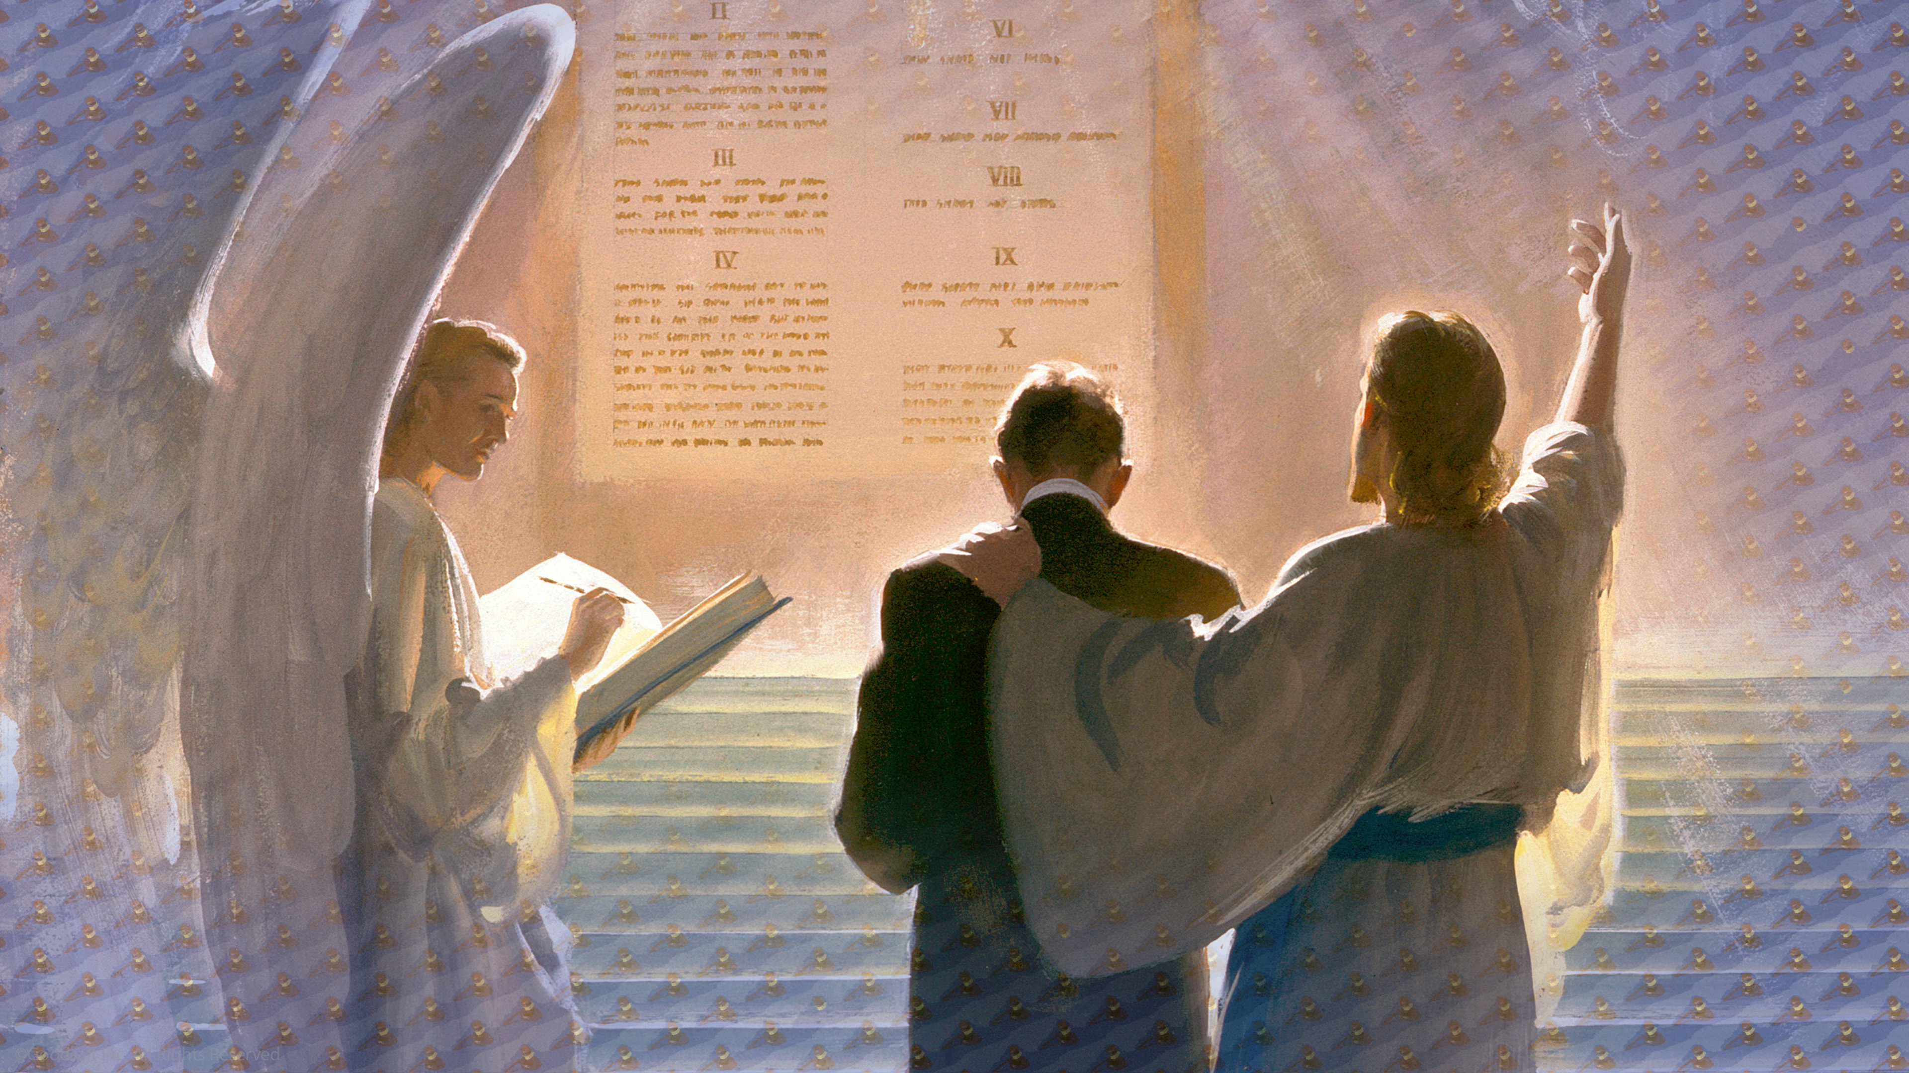
Notes:
God does not keep for Himself, but for our benefit, and the universe that is watching everything that is happening on Earth. After all, God knows everything. He does not need to keep records for Himself.
But Satan has made accusations about God and His character, so God wants each and every created being to be fully satisfied that the devil’s charges are not true, and that God really is loving, just, and fair!

Slide 40
Notes:
Remember the platypus. We only see a little part of what someone’s life is like, but God sees everything. He knows more about us than we know about ourselves.
Jesus described to His disciples how well God knows each of us “Even the very hairs of your head are all numbered.” I can’t even guess the number of hairs on my head, can you?

Slide 41
Notes:
I am happy that God knows us so well. There is never a chance that He will misunderstand any of us. He knows how to draw us to His way of Hope. The Bible tell us,
"The Lord is not slow in keeping his promise… not wanting anyone to perish, but everyone to come to repentance.” Repenting means to turn away from doing evil and towards Jesus.

Slide 42
Notes:
In the last book of the Bible Jesus tells us “Look, I am coming soon! My reward is with me, and I will give to each person according to what they have done.” Revelation 22:12 Those who have accepted Jesus’ gift of salvation do not worry about the Judgment because they know Jesus is the judge. And they know the Judge is their Lord and Savior.

Slide 43
Notes:
It’s because the Judgment is really about our relationship with Jesus, our Savior and Friend! It’s that relationship that will determine our eternal destiny. Jesus said “And this is eternal life, that they may know You, the only true God, and Jesus Christ whom You have sent.” John 17:3

Slide 44
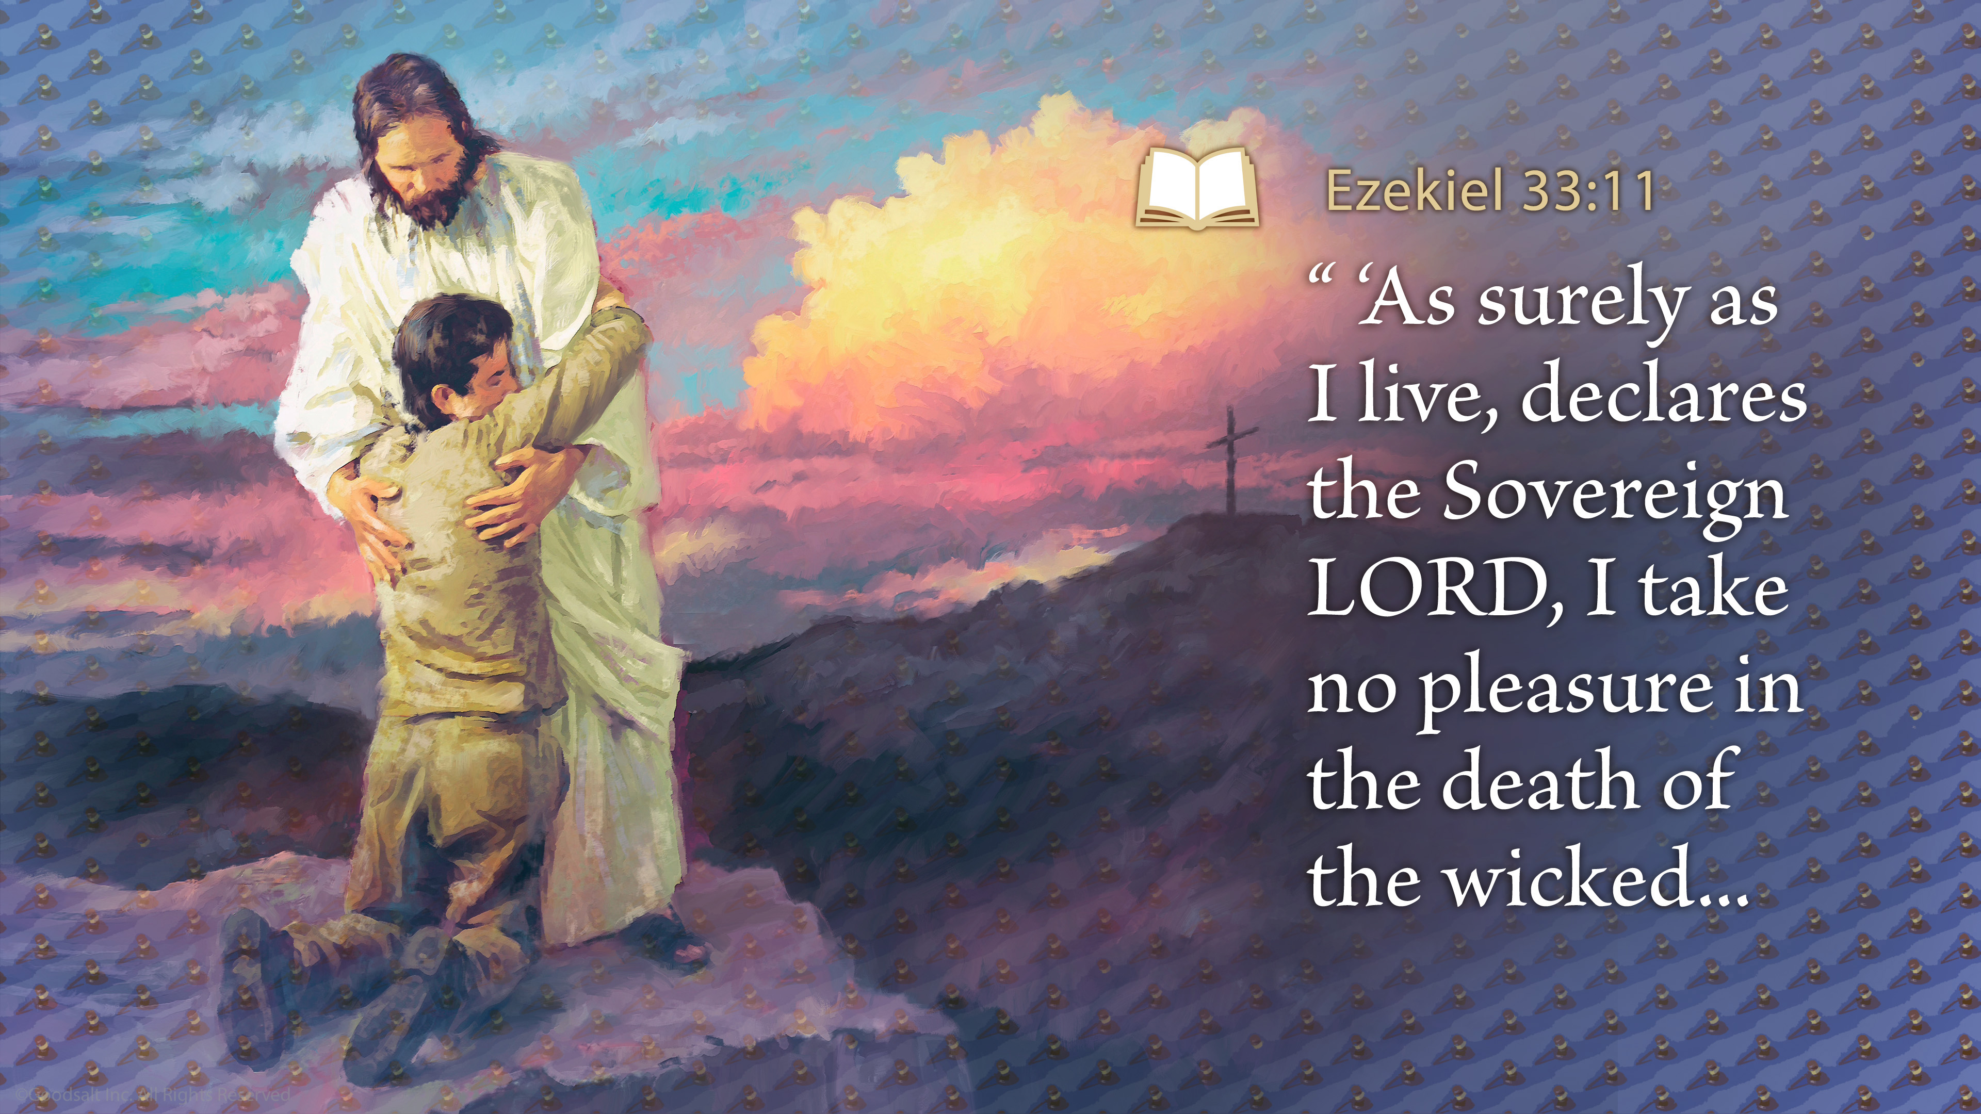
Notes:
Sadly we know that many people will decide they do not want Jesus’ gift, and He will have to let them go. Their lives will end forever. But He does not want that. We can never know how much that breaks God’s heart. God told His prophet Ezekiel to give this message to Israel. But that message is for us, too: “Say to them, ‘As surely as I live, declares the Sovereign LORD, I take no pleasure in the death of the wicked… Ezekiel 33:11

Slide 45
Notes:
… but rather that they turn from their ways and live. Turn! Turn from your evil ways! Why will you die… ?’” God calls people to repent and to step away from the dangerous cliff-edge of sin, to trust Him and accept His gift of eternal life.

Slide 46
Notes:
The Bible does not tell us when his Judgment will be finished, but it does tell us when God’s Judgment begins.
That is a complicated study and one that Bible students find fascinating. It involves very interesting historical dates, math, and history. The Judgment is important because it shows why some people were saved when Jesus returns and some were not.

Slide 47
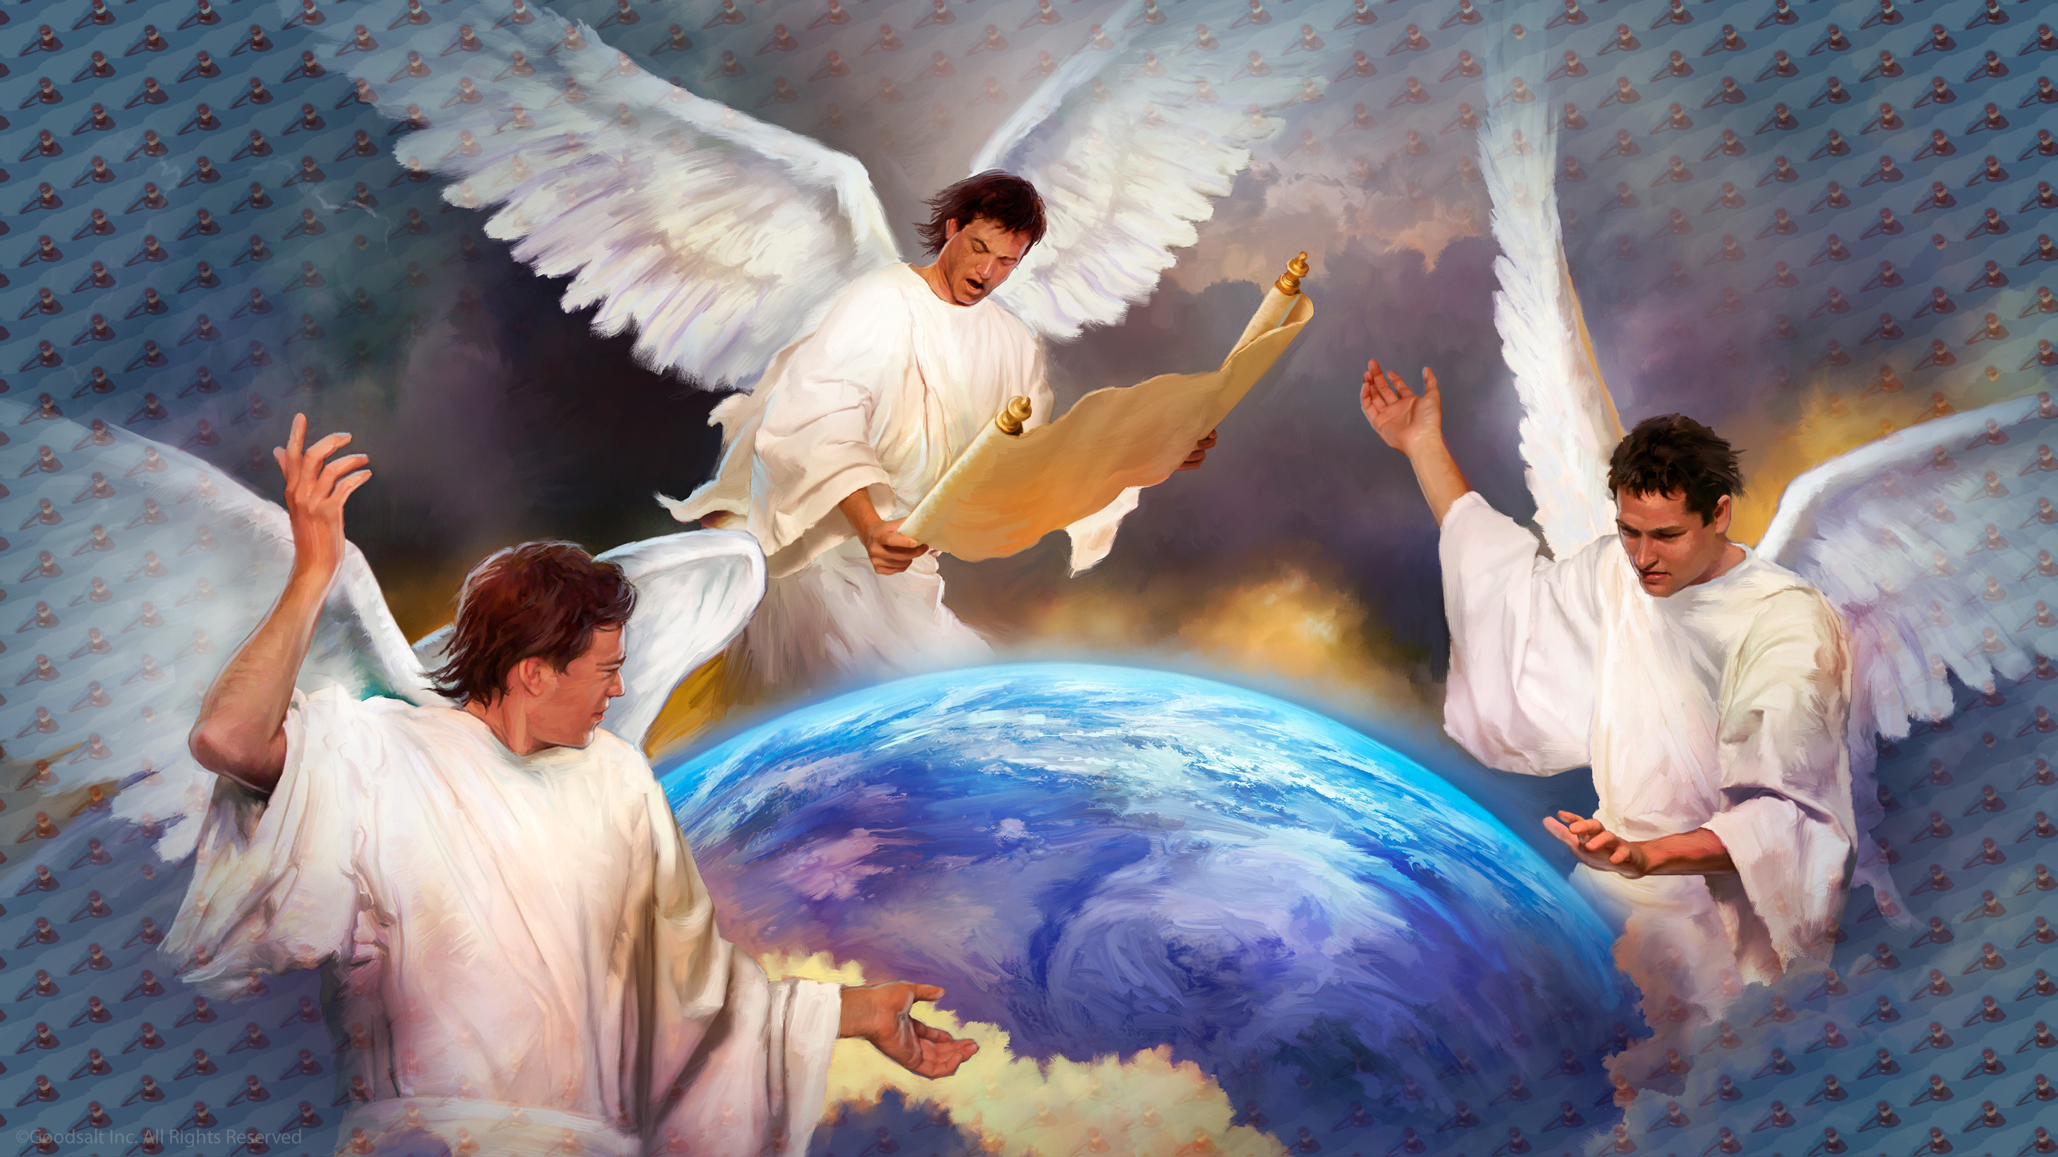
Notes:
The Bible describes this important work at the end of time and how God wants us to prepare. It is symbolized by three angels that Jesus’ disciple John saw in vision.
They have an important message for the people living in the last days, which we believe is now. Here is the message of the first angel:

Slide 48
Notes:
“Then I saw another angel flying in the midst of heaven, having the everlasting gospel…

Slide 49
Notes:
…to preach to those who dwell on the earth–to every nation, tribe, tongue, and people—

Slide 50
Notes:
…saying with a loud voice, ‘Fear God and give glory to Him, for the hour of his judgment has come;

Slide 51
Notes:
…and worship him who made heaven and earth, the sea and springs of water’ ”
(Revelation 14:6, 7)

Slide 52
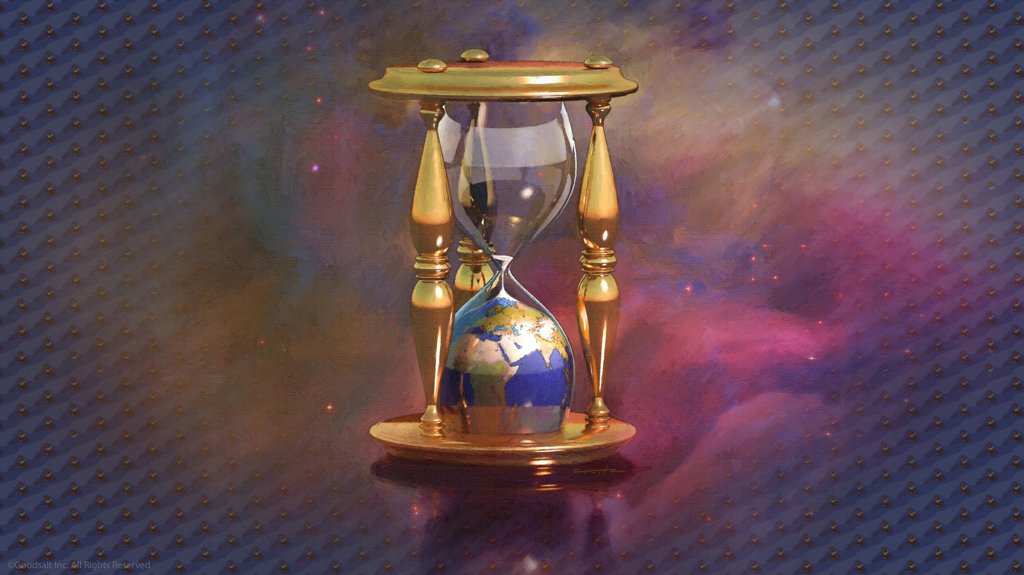
Notes:
God will not let sin go on forever. He patiently waits and guides us, giving us all many, many chances, but there is a time limit. There is a date, known only by God himself, in the future when God says “time is up!”

Slide 53
Notes:
God wants us to accept Him as our Savior and Lord now. It is the most important decision we will ever make. And a decision we should not carelessly make. We want the books of Heaven to show that we accepted Jesus with all our heart.

Slide 54
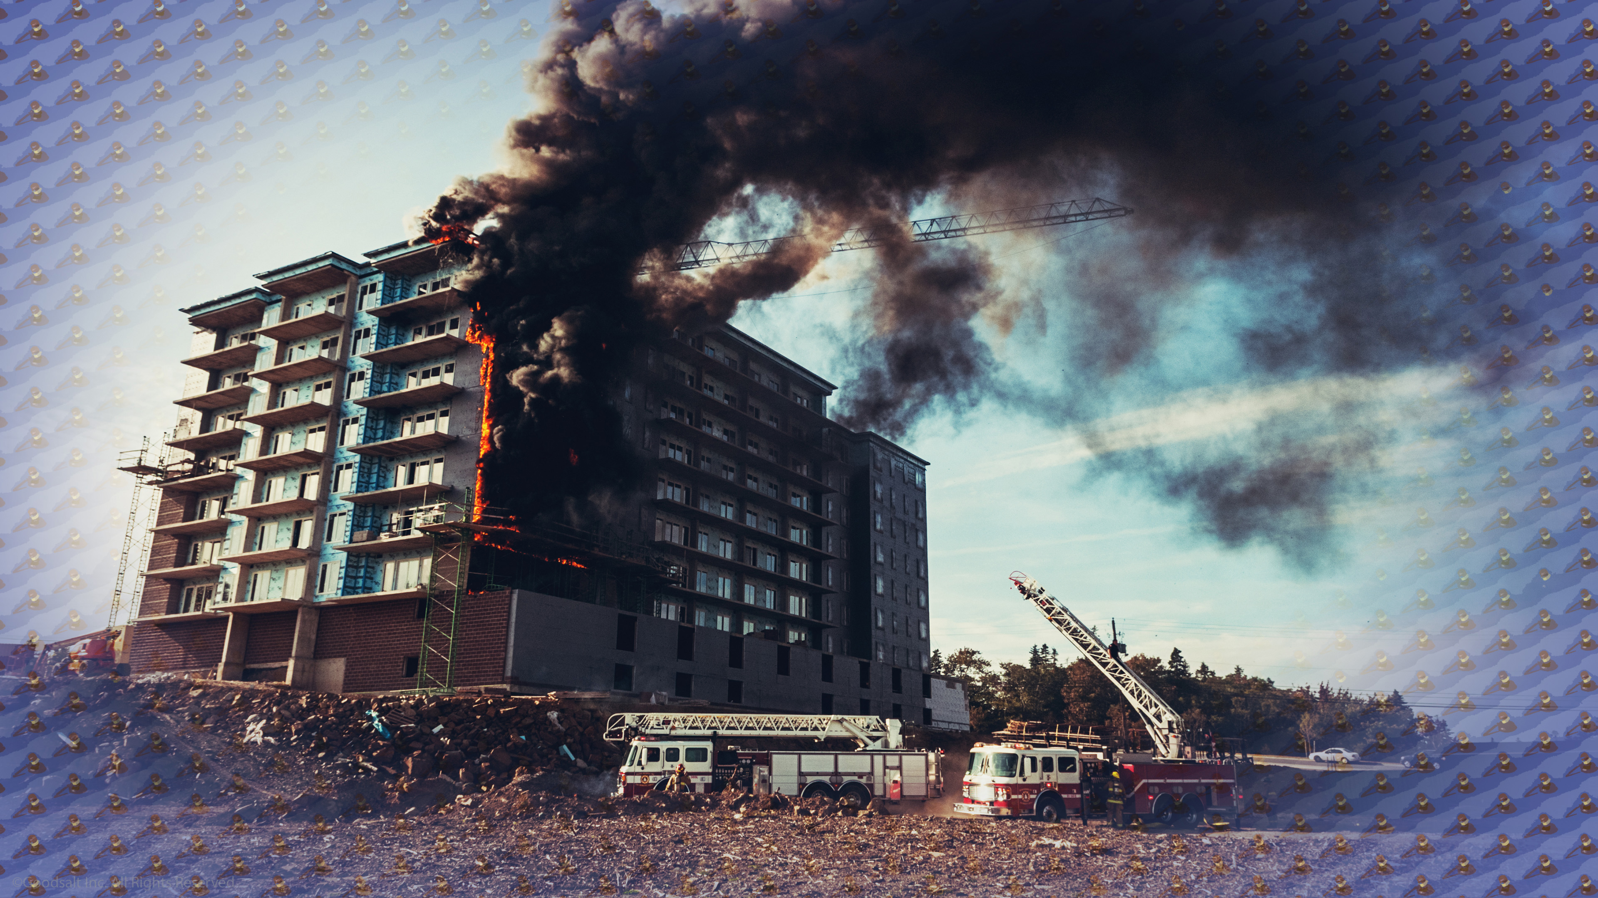
Notes:
But none of us know when something might happen to us. We don’t want to put off choosing Jesus. If we had someone that we loved inside a building that had caught on fire, would we be concerned if they put off leaving the building? Of course we would!

Slide 55
Notes:
If you have chosen God as your Lord and are a part of His kingdom, you can have faith that He is on your side. When your name comes up in the Judgment,
Jesus steps in and says, “Hold on, this one is mine! I paid for her sin with my own blood. I have a mansion prepared just for her. I have great plans ahead for her. And like a judge rendering a decision with a gavel, Jesus says, “Case dismissed! We can move on to the next case.”

Slide 56
Notes:
If you have chosen God as your Lord and are a part of His kingdom, you can have faith that He is on your side. When your name comes up in the Judgment,
Jesus steps in and says, “Hold on, this one is mine! I paid for her sin with my own blood. I have a mansion prepared just for her. I have great plans ahead for her. And like a judge rendering a decision with a gavel, Jesus says, “Case dismissed! We can move on to the next case.”

Slide 57
Notes:
That is why God’s Judgment is awesome. None of us deserve to be saved, but Jesus has taken our place. He suffered and die so that we would not have to. By faith we accept His righteousness for our sinfulness.
What a miracle! In the Judgment He is both our Lawyer and our Judge! Through Jesus we cannot lose! In Him there is only victory!

Slide 58
Notes:
[Suggested Prayer]
Lord, we are so grateful that You know each of us. We thank you for your promise that one day, all sin, selfishness, and suffering will end.
Thank you, Jesus, that we don’t have to fear the Judgment. Thank you for being on our side and loving us so much.
Amen

